Slide 1

The Browning & Greying of America: Implications for the Central Ohio Region
James H. Johnson, Jr.
Frank Hawkins Kenan Institute of Private Enterprise
Kenan-Flagler Business School
University of North Carolina at Chapel Hill
June 2017

Slide 2
OVERVIEW
Two colorful demographic processes
The Triple Whammy of Geographic Disadvantage
Implications for Central Ohio Regional Competitiveness

Slide 3
Two ‘colorful’ demographic processes are drivers of change
Browning & Graying of America

Slide 4
The “Browning” of America
Immigration-driven population change

Slide 5
U.S. Immigrant Population,
1900-2014

Slide 6
U.S. Foreign Born Population by Race/Ethnicity, 2014
Race/Ethnicity | Foreign Population | Share of Total (%)
Total | 42,235,749 | 100.0
Hispanic | 19,300,947 | 45.7
White Alone, not Hispanic | 7,655,008 | 18.1
Black Alone, not Hispanic | 3,377,733 | 8.0
Asian Alone, not Hispanic | 11,036,059 | 26.1
Other Alone, not Hispanic | 866,002 | 2.1

Slide 7

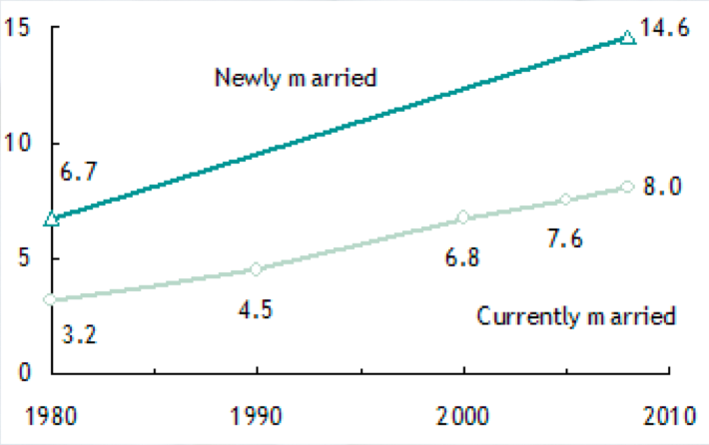
INTERMARRIAGE TREND, 1980-2008
% Married Someone of a Different Race/Ethnicity

Slide 8

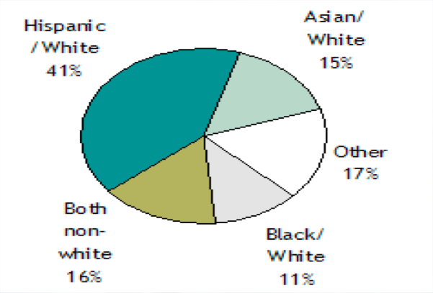
INTERMARRIAGE TYPES
Newly Married Couples in 2008

Slide 9
NON-WHITE AND HISPANIC SHARES OF POPULATION GROWTH, 2000-2010
Area | Absolute Population Change | Non-White Share | Hispanic Share
US | 27,323,632 | 91.7 | 55.5
South | 14,318,924 | 79.6 | 46.4
Texas | 4,293,741 | 89.2 | 65.0
Florida | 2,818,932 | 84.9 | 54.7
Georgia | 1,501,206 | 81.0 | 27.9
NC | 1,486,170 | 61.2 | 28.3
Central Ohio Region | 238,835 | 59.6 | 16.7

Slide 10
MEDIAN AGE OF U.S. POPULATION BY RACE, HISPANIC ORIGIN & GENDER, 2014
Race | Total | Male | Female
United States | 37.7 | 36.3 | 39.0
White Alone | 40.4 | 39.0 | 39.6
White, Non-Hispanic | 43.1 | 41.7 | 41.8
Black Alone | 33.4 | 31.6 | 35.1
AI/AN Alone | 32.5 | 31.1 | 33.6
Asian Alone | 36.5 | 35.3 | 37.7
NH/PI Alone | 30.8 | 30.3 | 31.6
Two or More Races | 19.6 | 19.1 | 20.2
Hispanic | 28.4 | 27.9 | 29.1
Notes:
Source: U.S. Census Bureau, Annual Population Estimates by Age, Sex, Race, and Hispanic Origin

Slide 11
RELATIVE DISTRIBUTION OF U.S. BIRTHS BY RACE / ETHNICITY
Race/Ethnicity | 1990 | 2008 | 2011
White | 66% | 50% | 49.6%
Blacks | 17% | 16% | 15.0%
Hispanics | 15% | 26% | 26.0%
Other | 2% | 8% | 9.4%
Source: Johnson and Lichter (2010); Tavernise (2011).

Slide 12
RELATIVE DISTRIBUTION OF U.S. POPULATION BY RACE / ETHNICITY
Race/Ethnicity | 2005 | 2050
White | 67% | 47%
Blacks | 12.8% | 13%
Hispanics | 14% | 29%
Asian | 5% | 9%
Source: Pew Research Center, 2008 *projected.

Slide 13
Central Ohio Population Change, 2000-2010
Area | 2010 Population | Absolute Change 2000-2010 | Percent Change 2000-2010
Midwest | 66,972,887 | 2,480,998 | 3.0%
Ohio | 11,536,504 | 183,364 | 1.6%
Central Ohio Region | 2,182,348 | 238,835 | 12.3%

Slide 14
CENTRAL OHIO REGION POPULATION CHANGE BY RACE & ETHNICITY, 2000-2010
Race | 2010 Population | Absolute Change 2000 – 2010 | Percentage Change 2000 - 2010
Total | 2,182,348 | 238,835 | 12.3%
Non-Hispanic | 2,111,448 | 199,025 | 10.4%
White | 1,717,299 | 96,683 | 6.0%
Black | 280,902 | 64,835 | 30.0%
AI/AN | 4,304 | -183 | -4.1%
Asian | 58,348 | 20,586 | 54.5%
NH/PI | 922 | 353 | 62.0%
Some other race | 3,749 | 659 | 21.3%
2 or More Races | 45,924 | 6,092 | 53.9%
Hispanic | 70,900 | 39,810 | 128.0%
Notes:
Source: U.S. Census Bureau, Annual Population Estimates by Sex, Race, and Hispanic Origin

Slide 15
Female Median Age, Central Ohio Region, 2010-2014
 | Total | White | Black | Latino
Delaware | 38 | 39.4 | 34.9 | 23.8
Fairfield | 40.2 | 41.7 | 34.4 | 26.0
Fayette | 41.6 | 41.8 | 48.7 | 30.1
Franklin | 34.8 | 38.2 | 32.0 | 24.1
Hocking | 43.0 | 43.2 | 30.4 | 26.0
Knox | 39.7 | 40.6 | 33.2 | 22.6
Licking | 40.7 | 41.8 | 33.9 | 23.5
Logan | 41.4 | 42.4 | 50.2 | 22.2
Madison | 41.8 | 42.3 | 43.5 | NA
Marion | 42.3 | 40.6 | 38.4 | 22.4
Morrow | 41.6 | 41.8 | 19.7 | 20.1
Perry | 40.3 | 42.4 | NA | NA
Pickaway | 40.5 | 42.3 | 18.6 | 23.5
Ross | 41.4 | 43.6 | 43.9 | NA
Union | 37.6 | 42.2 | 33.9 | 27.3
Notes:
Source: 2010-2014 American Community Survey.

Slide 16
Central Ohio Population Change, 2010-2015
Area | 2015 Population | Absolute Change 2010-2015 | Percent Change 2010-2015
Midwest | 67,907,403 | 929,898 | 1.4%
Ohio | 11,613,423 | 76,919 | 0.7%
Central Ohio Region | 2,229,233 | 116,885 | 5.4%

Slide 17
Balance of Population Change Equation
Population Change = In-Flows – Out-Flows
where
In-flows = [Births + In-Migrants]
&
Out-Flows =[Deaths + Out-Migrants]

Slide 18
Typology of Communities
Demographic Experience | Drivers
Balanced Growth | Births exceed deaths and in-migration exceeds out-migration.
Natural Growth | Out-migration exceeds in-migration but this population loss is offset by an excess of births over deaths.
Migration Magnets | Deaths exceed births but population loss is averted because in-migration exceeds out-migration.
Dying | Deaths exceed births and out-migration exceeds in-migration, resulting in population loss.
Biologically Declining | In-migration exceeds out-migration but his net migration is not substantial enough to offset an excess of deaths over births
Emptying Out | Births exceed deaths but out-migration exceeds in-migration, resulting in net population loss

Slide 19
Types of Communities in the Central Ohio, 2010-2015
Type of Community | Number
Balanced Growth | 8
Natural Growth | 1
Migration Magnet | 0
Emptying Out | 6
Dying | 0
Biologically Declining | 0

Slide 20
Estimated Change Central Ohio,
2010-2015
Area | Total Population Change | Natural Change | Net Migration
Central Ohio | 116,885 | 67,035 | 50,856

Slide 21
Net Migration Central Ohio,
2010-2015
Area | Total Net Migration | International Net Migration | Domestic Net Migration
Central Ohio | 50,856 | 30,600 | 20,256

Slide 22
Balanced Growth Counties, 2010-2015
County | Total Population Change | Natural Change | Net Migration
Franklin | 88,177 | 50,736 | 38,692
Delaware | 18,824 | 6,260 | 12,142
Fairfield | 5,256 | 2,676 | 2,349
Licking | 4,090 | 2,482 | 1,653
Union | 2,010 | 1,475 | 472
Pickaway | 1,300 | 552 | 763
Madison | 664 | 200 | 478

Slide 23
Natural Growth Counties, 2010-2015
County | Total Population Change | Natural Change | Net Migration
Morrow | 247 | 395 | -152

Slide 24
Emptying Out Counties, 2010-2015
County | Total Population Change | Natural Change | Net Migration
Marion | -1,146 | 424 | -1,471
Ross | -894 | 190 | -989
Hocking | -884 | 89 | -823
Logan | -472 | 403 | -856
Fayette | -351 | 59 | -444
Perry | -67 | 443 | -463

Slide 25
The “Graying” of America
The Silver Tsunami is about to hit

Slide 26
Key Drivers
Changes in Longevity
Declining Fertility
Aging of Boomer Cohort

Slide 27
Average Life Expectancy through History
Period | Life Expectancy
Cro-Magnon Era | 18
The Renaissance | 30
America in 1850 | 43
America Today | 78
Developed World in 2030 | 101
Source: Arrison (2011)

Slide 28
TOTAL FERTILITY RATES FOR U.S. WOMEN BY RACE/ETHNICITY, 2012
Race/Ethnicity | Total Fertility Rate
All Races | 1.88
Hispanic | 2.18
Non-Hispanic White | 1.76
Blacks | 1.90
Asian | 1.77
Native American | 1.35
Notes:
Source: National Vital Statistics Reports, Vol. 62, No. 3, September 6, 2013.

Slide 29
U.S. POPULATION CHANGE BY AGE, 2000-2010
Age | 2010 | Absolute Change 2000 - 2010 | Percentage Change 2000 - 2010
<25 | 104,853,555 | 5,416,289 | 5.4%
25-44 | 82,134,554 | -2,905,697 | -3.4%
45-64 | 81,489,445 | 19,536,809 | 31.5%
65+ | 40,267,984 | 5,276,231 | 15.1%
TOTAL | 308,745,538 | 27,323,632 | 9.7%
Notes:
Source: U.S. Census Bureau, Population Estimates by Sex and Age.

Slide 30
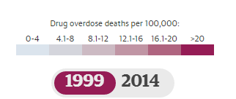
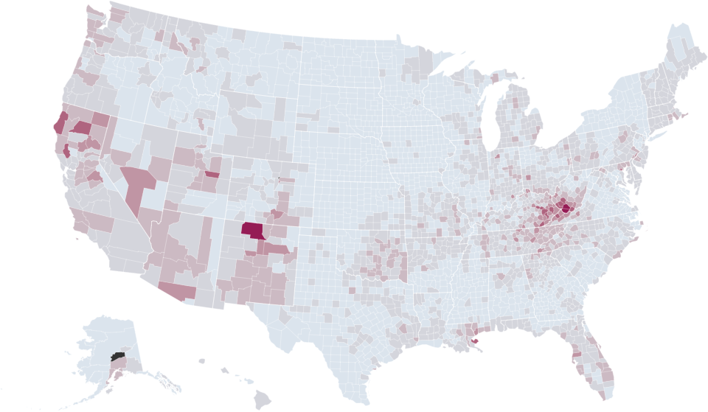
The Drug Overdose Crisis in 1999

Slide 31
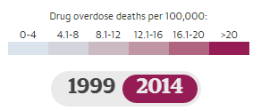
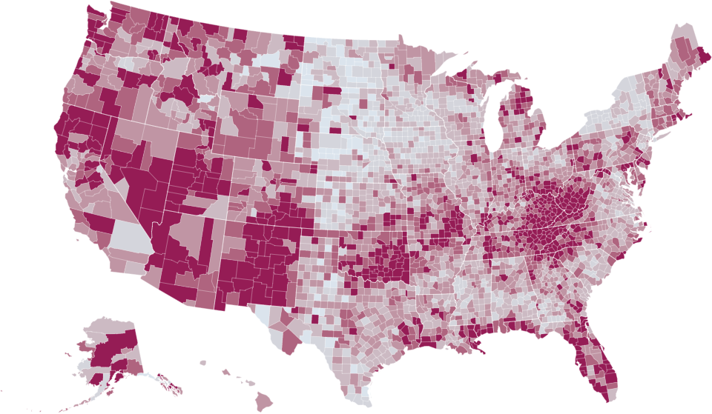
The Drug Overdose Crisis in 2014

Slide 32
U.S. POPULATION TURNING 50, 55, 62, AND 65 YEARS OF AGE, (2007-2015)
 | Age 50 | Age 55 | Age 62 | Age 65
Average Number/Day | 12,344 | 11,541 | 9,221 | 8,032
Average Number/Minute | 8.6 | 8.0 | 6.4 | 5.6

Slide 33
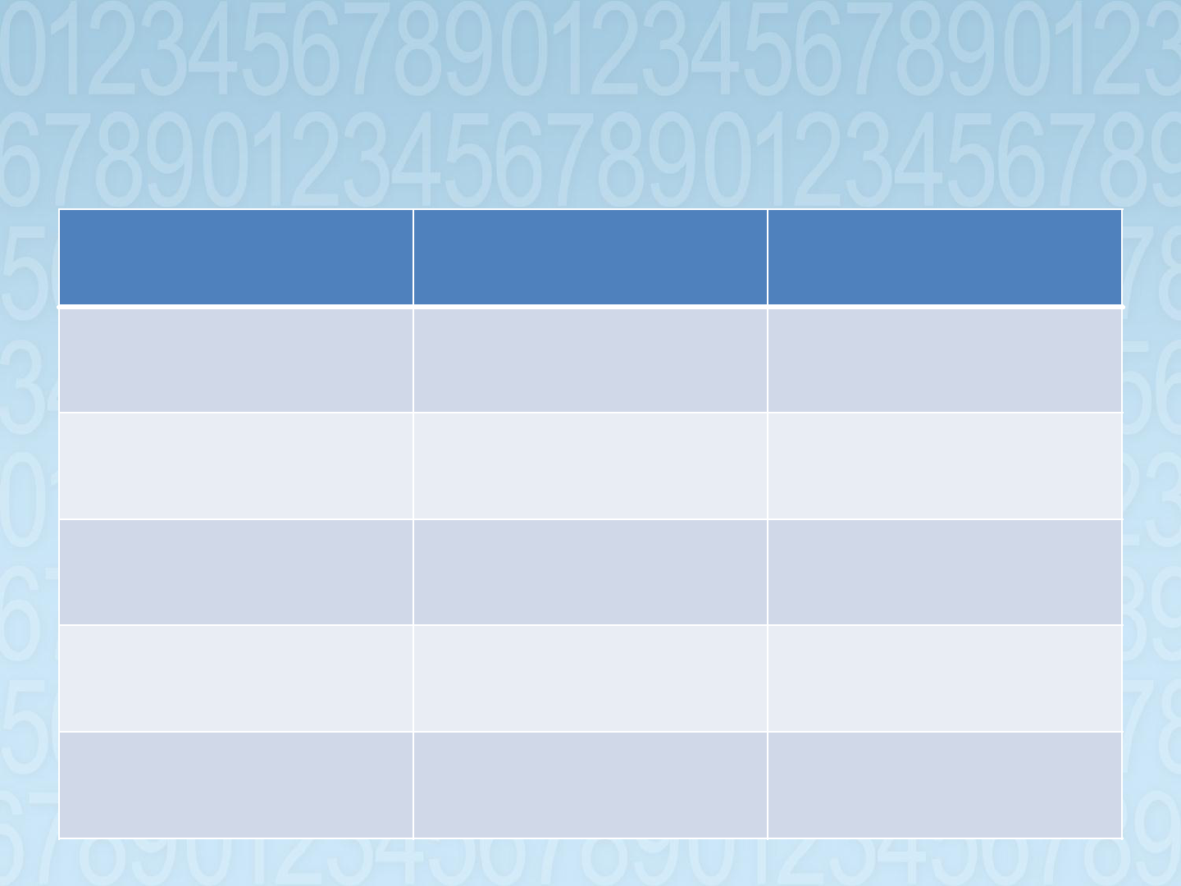
Absolute and Percent Population
Change by Age, 2000-2010
Age
United States
Central Ohio
All Ages
27,323,632
238,835
(9.7%)
(12.3%)
<25
5,416,292
61,802
(5.4%)
(8.9%)
25-44
-2,905,697
-6,790
(-3.4%)
(-1.1%)
45-64
19,536,809
145,574
(31.5%)
(34.7%)
65+
5,276,231
38,249
(15.1%)
(18.6%)

Slide 34
Absolute and Percent Population Change, Columbus, OH, 2010-2015
Age | 2015 Population | Absolute Change 2010-2015 | Percent Change 2010-2015
Total | 849,067 | 59,128 | 7.5
<25 | 288,683 | -3,544 | -1.2
25-44 | 288,683 | 28,004 | 10.7
45-64 | 186,795 | 13,008 | 7.5
65+ | 84,907 | 19,343 | 29.5

Slide 35
Older Adult Household Types, Columbus, OH, 2015
Type | Households (%) | Persons in Households (%)
Total | 84,698 (100%) | 173,510 (100%)
Group Quarters | N/A | 3,801 (2.2%)
One Generation | 67,112 (79.2%) | 101,347 (58.4%)
Two Generations | 11,261 (13.3%) | 37,635 (21.7%)
Three + Generations | 6,325 (7.5%) | 31,447 (18.1%)

Slide 36
Older Adult Living Arrangements, Columbus, OH, 2015
Type | Households (%) | Persons in Households (%)
ALL | 84,698 (100.0%) | 173,510 (100.0%)
Institutionalized | N/A | 3,801 (2.2%)
Independent | 67,112 (79.2%) | 101,347 (58.4%)
Caretaker | 12,116 (14.3%) | 46,190 (26.6%)
Caregiver | 5,420 (6.4%) | 22,892 (13.4%)

Slide 40
The Triple Whammy of Geographical Disadvantage
The Human Capital Challenge

Slide 41
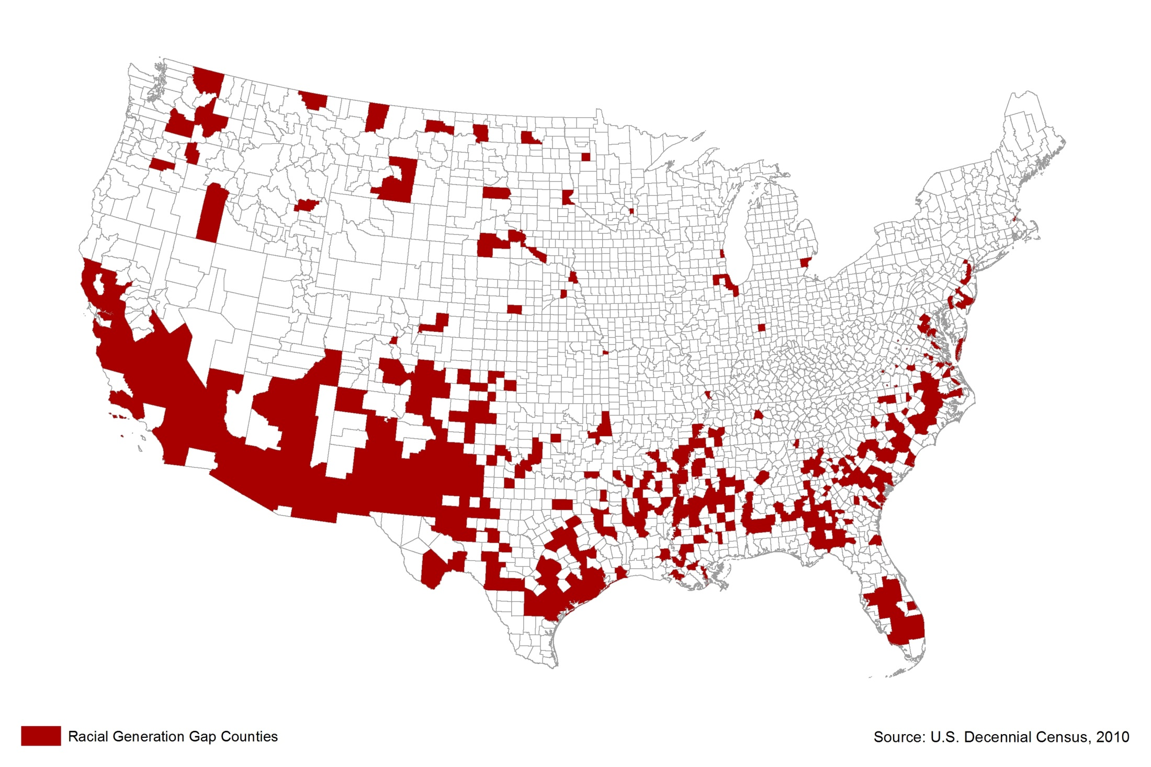
Racial Typology of U.S. Counties

Slide 42
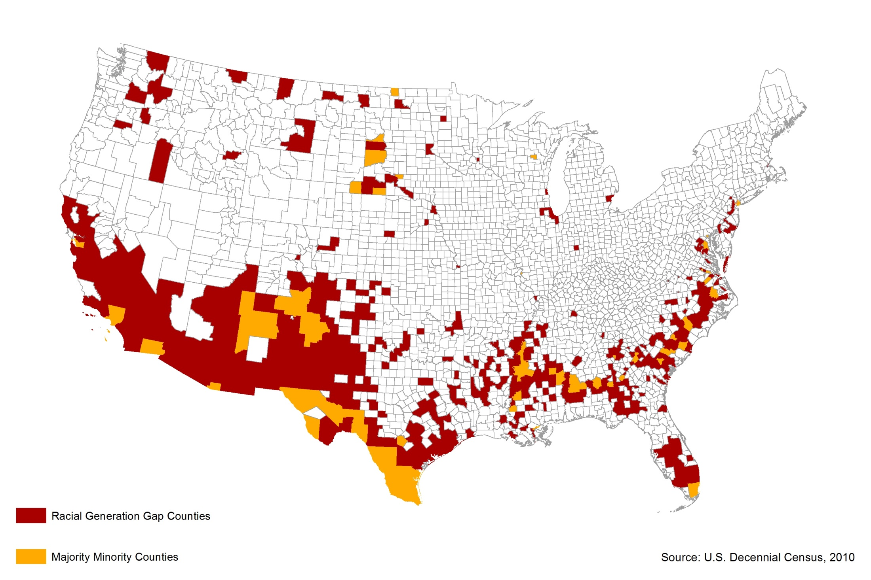
Racial Typology of U.S. Counties

Slide 43
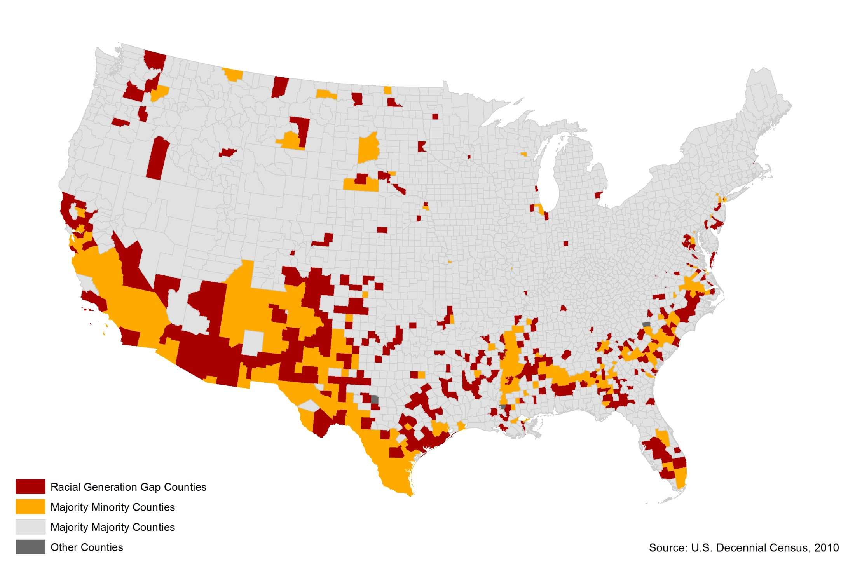
Racial Typology of U.S. Counties

Slide 44
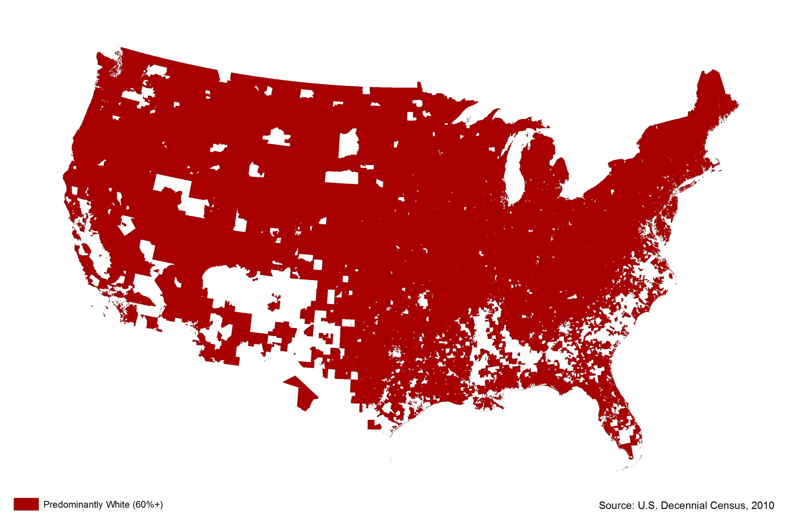
U.S. Racial Segregation by Census Tract

Slide 45
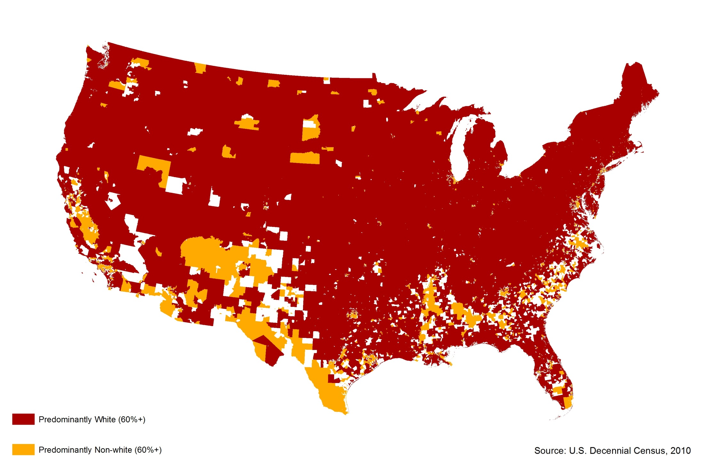
U.S. Racial Segregation by Census Tract

Slide 46
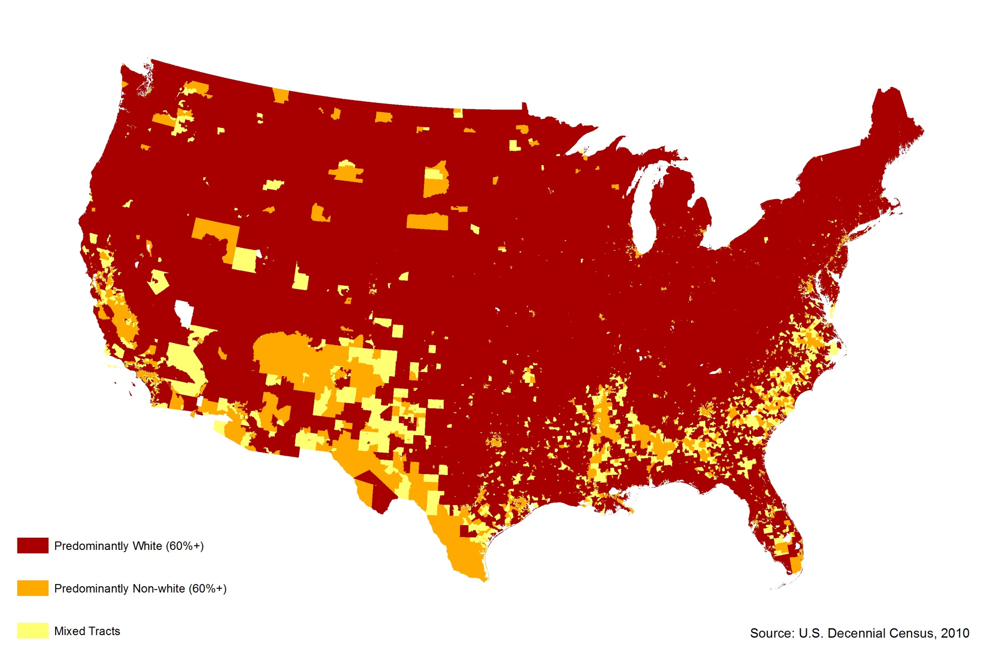
U.S. Racial Segregation by Census Tract

Slide 47
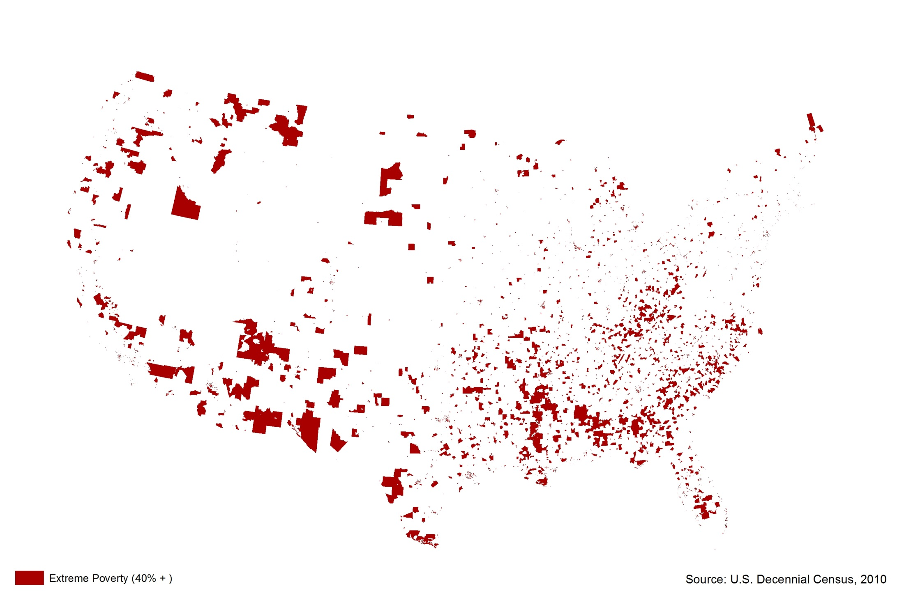
U.S. School Age Poverty by Census Tract

Slide 48
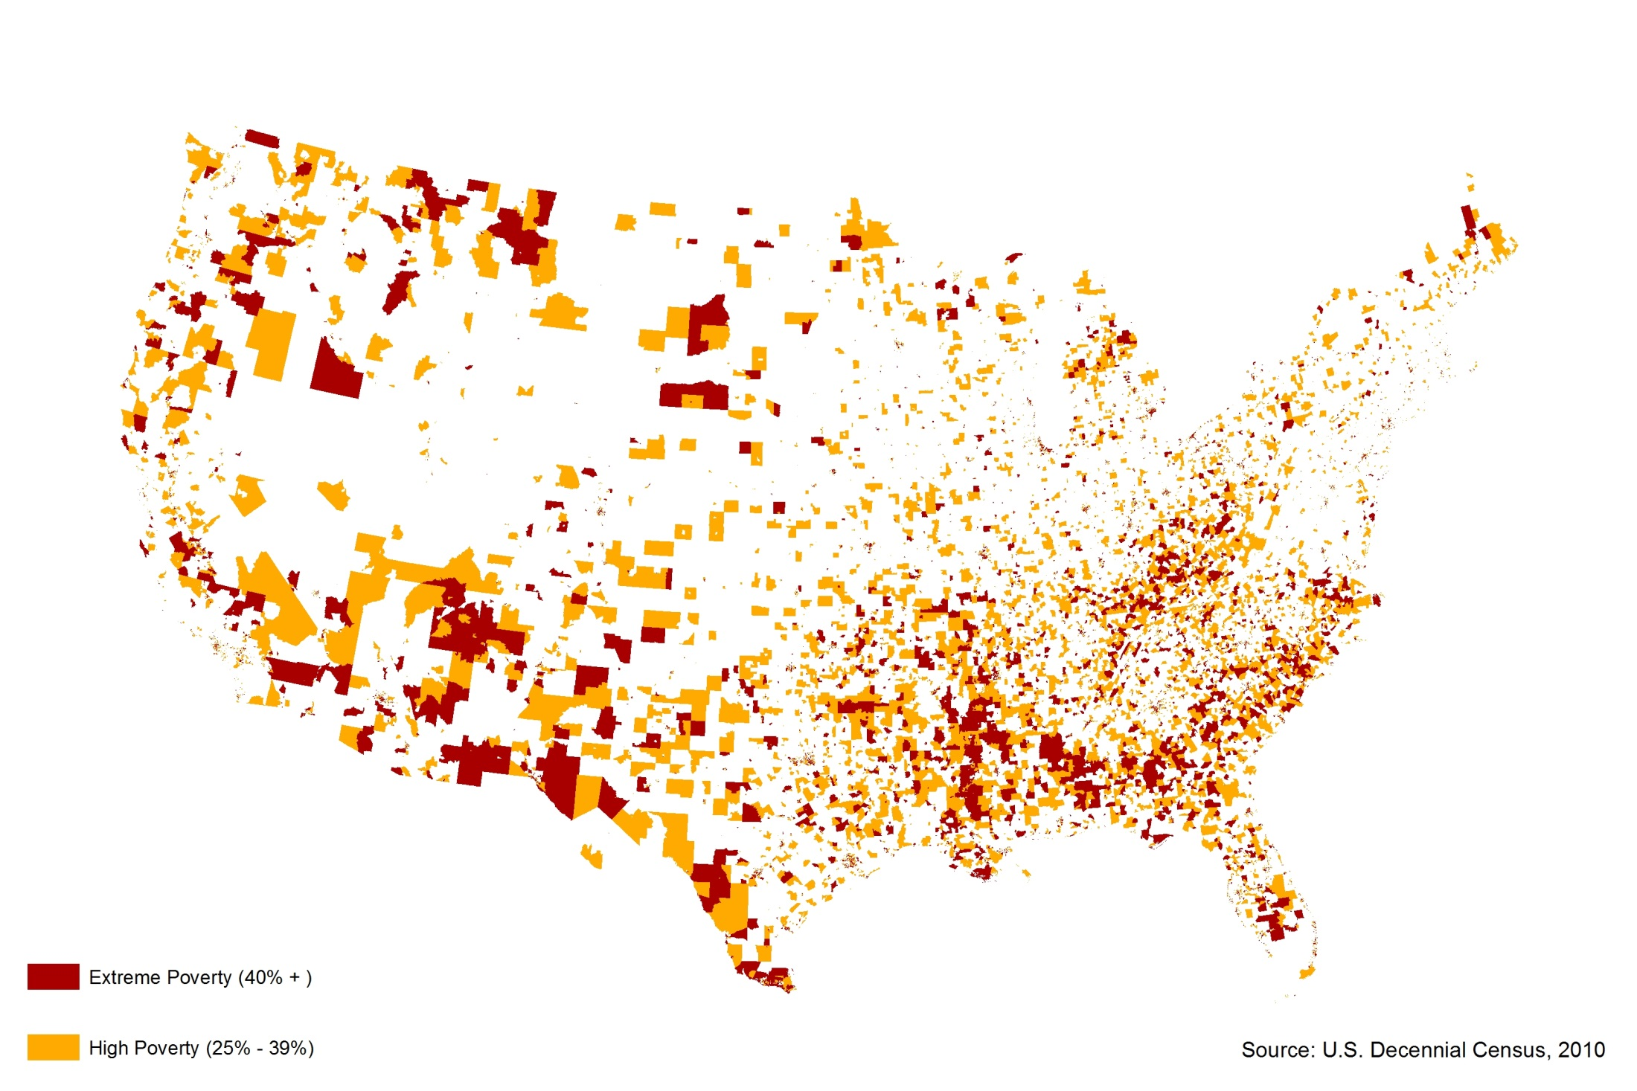
U.S. School Age Poverty by Census Tract

Slide 49
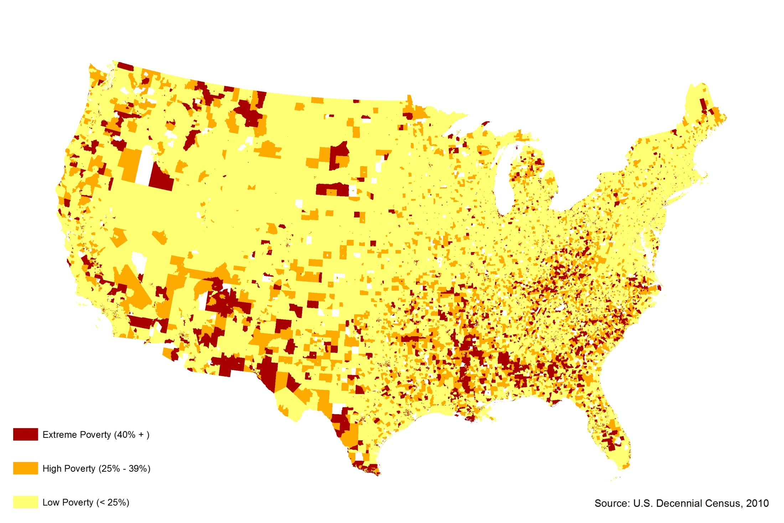
U.S. School Age Poverty by Census Tract

Slide 50
The Triple Whammy of Geographic Disadvantage

Slide 51
Summary Indicators of Exposure
Level of Vulnerability | Number of Youth | Percent Non-White
Triple Whammy | 9.8 million | 93
Double Whammy | 12.2 million | 81
Single Whammy | 20.0 million | 39
No Whammy | 32.1 million | 24

Slide 52
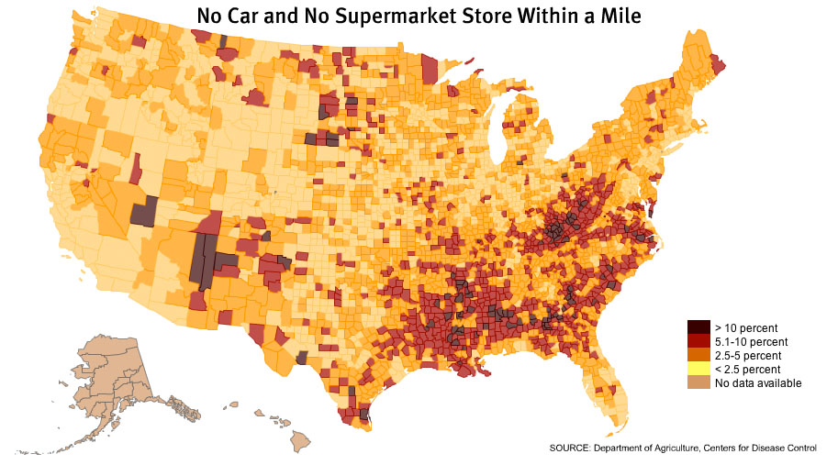

Slide 53
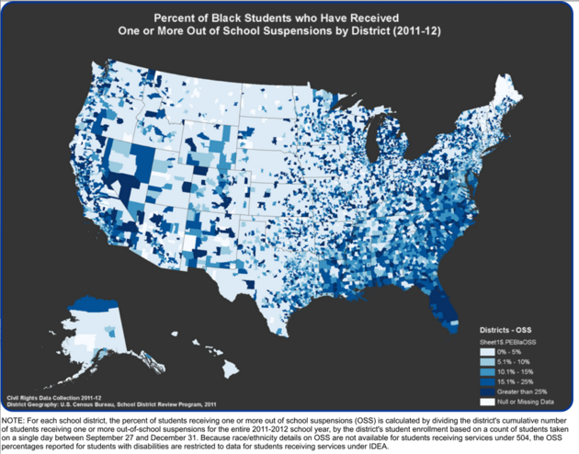

Slide 54
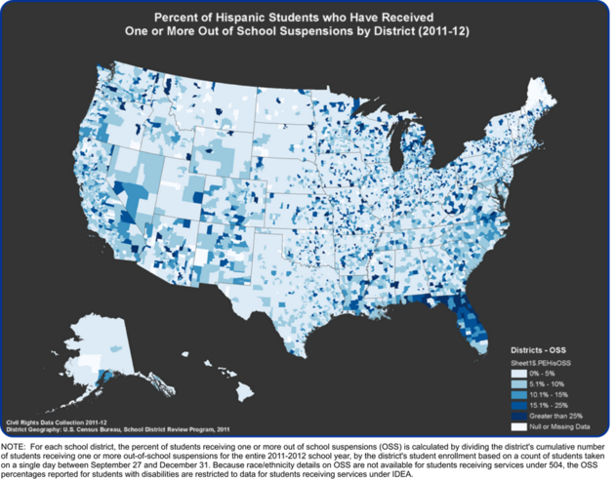

Slide 55
Central Ohio’s Triple Whammy of Geographical Disadvantage
The Human Capital Challenge

Slide 56
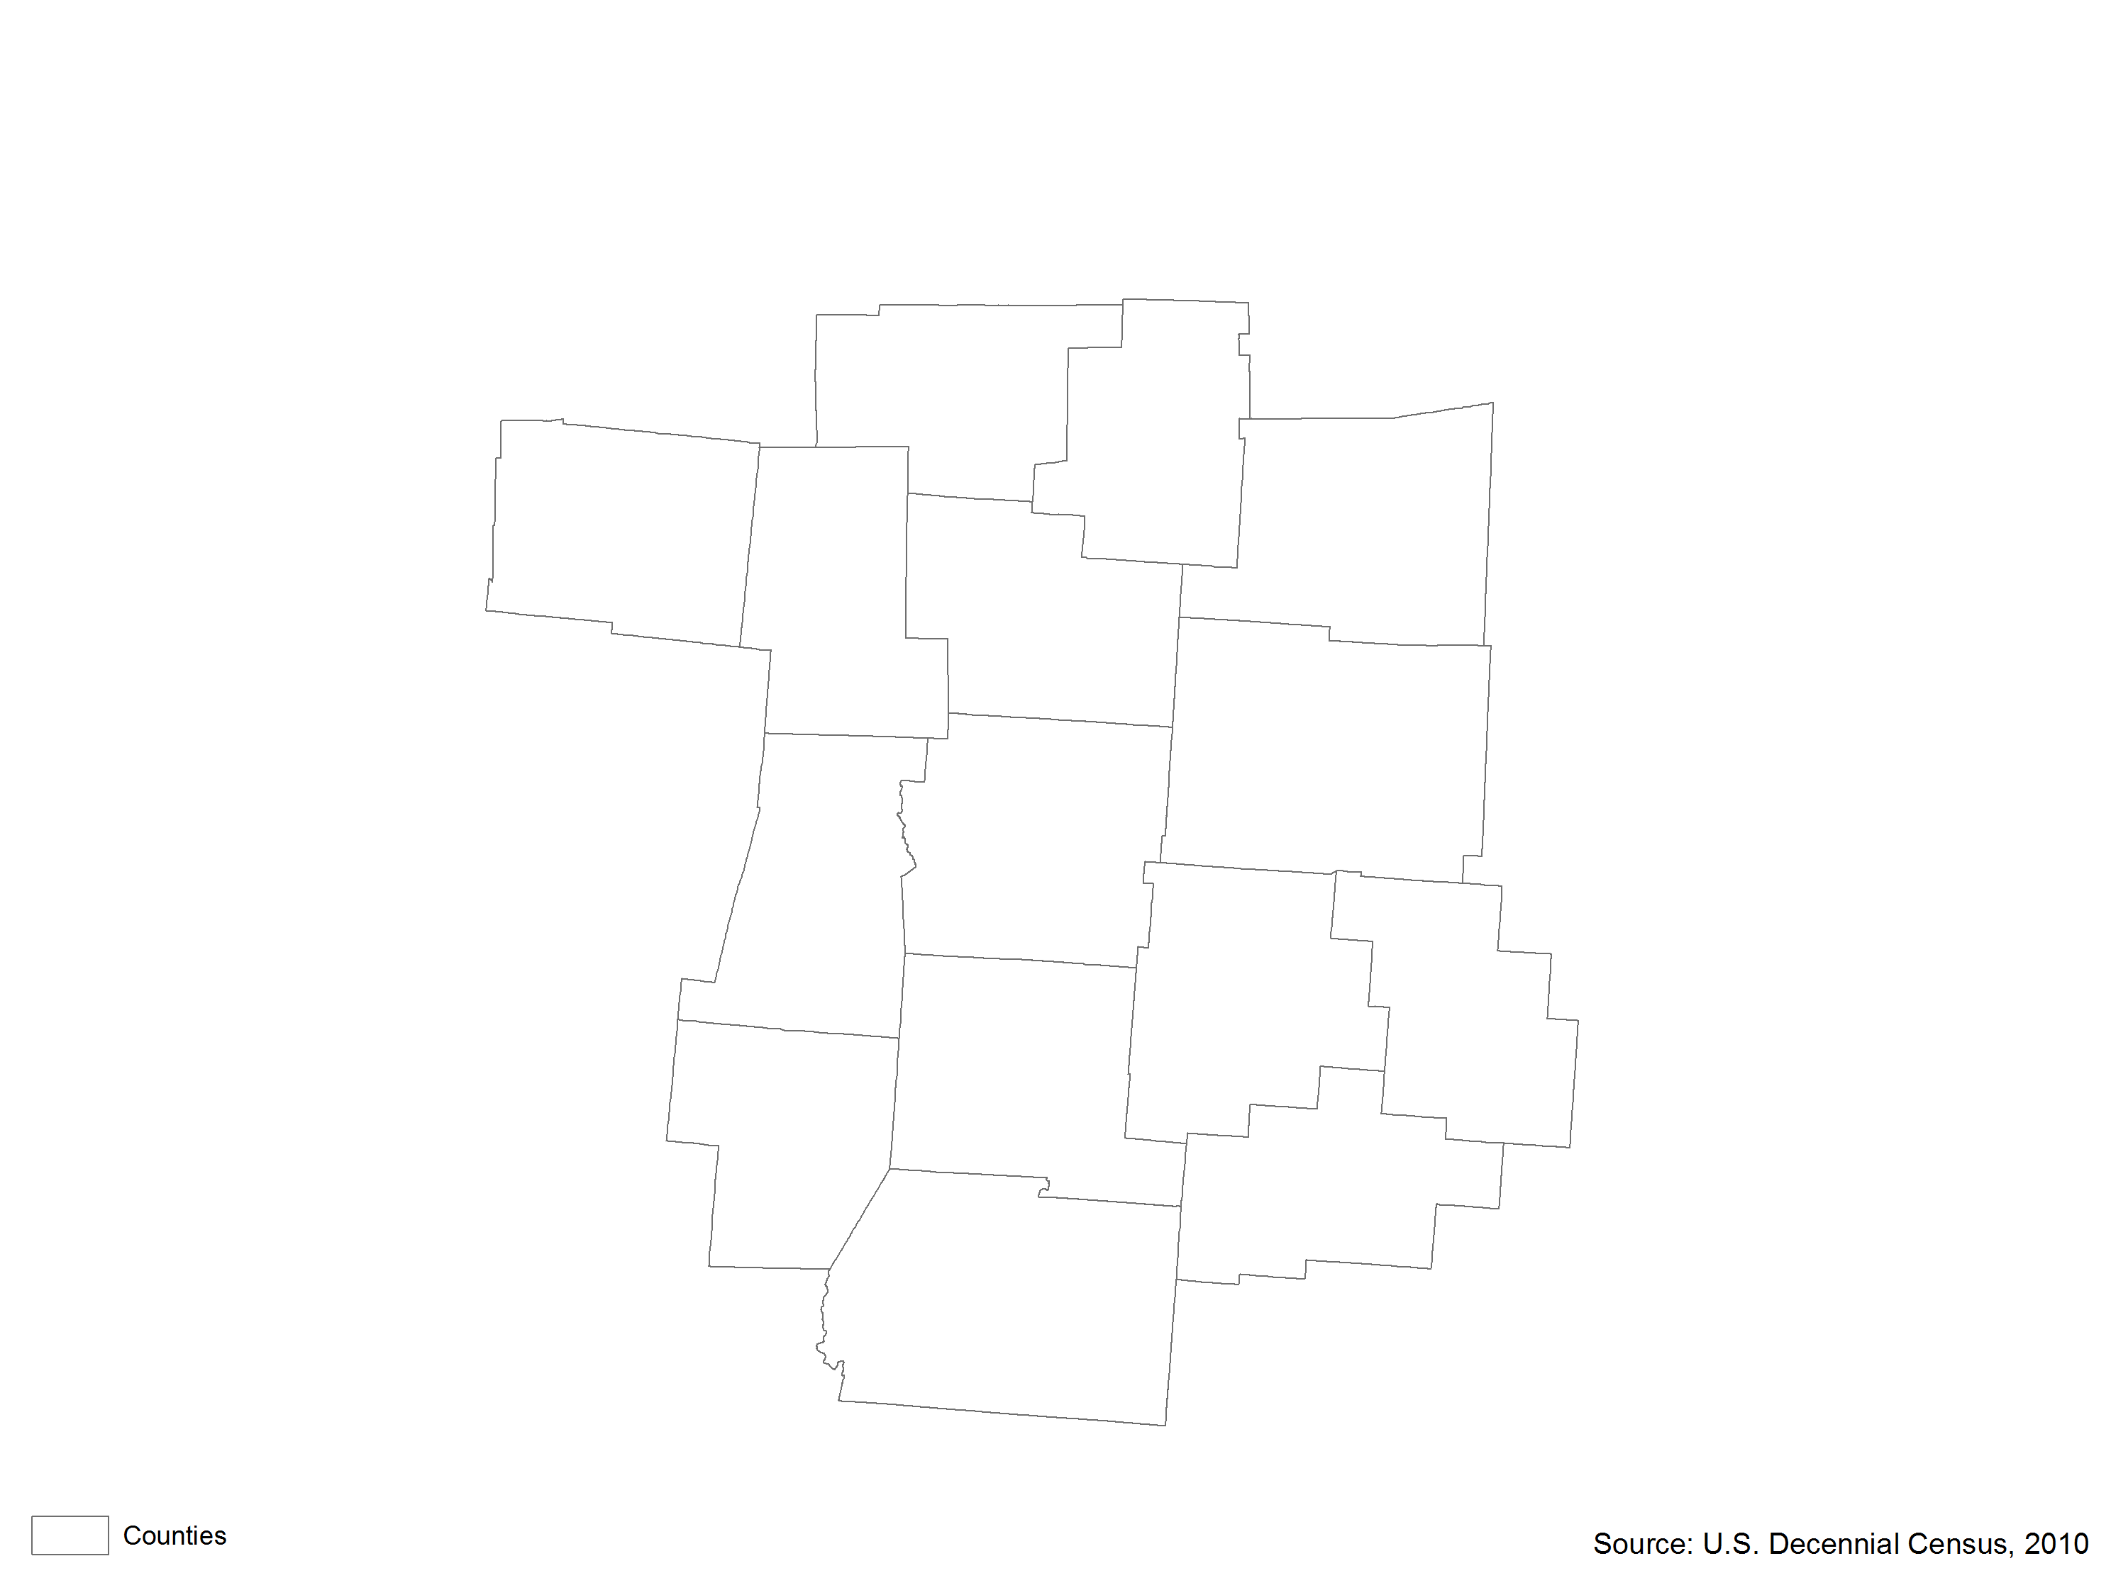
Racial Typology of Central Ohio Region

Slide 57
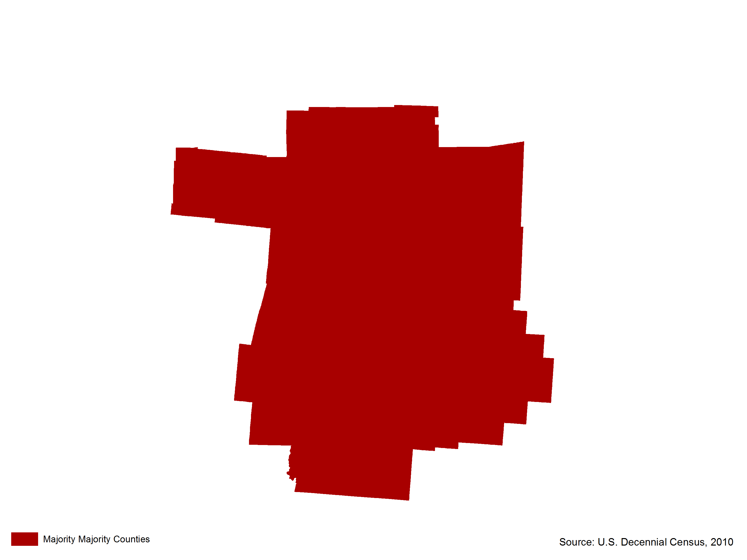
Racial Typology of Central Ohio Region

Slide 58
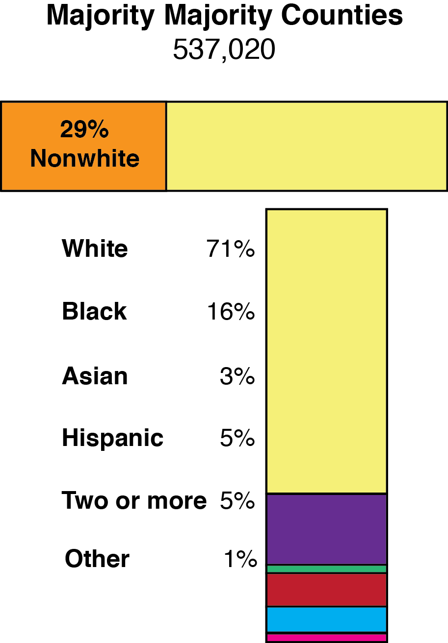
Distribution of School Age Population by Racial County Typology

Slide 59
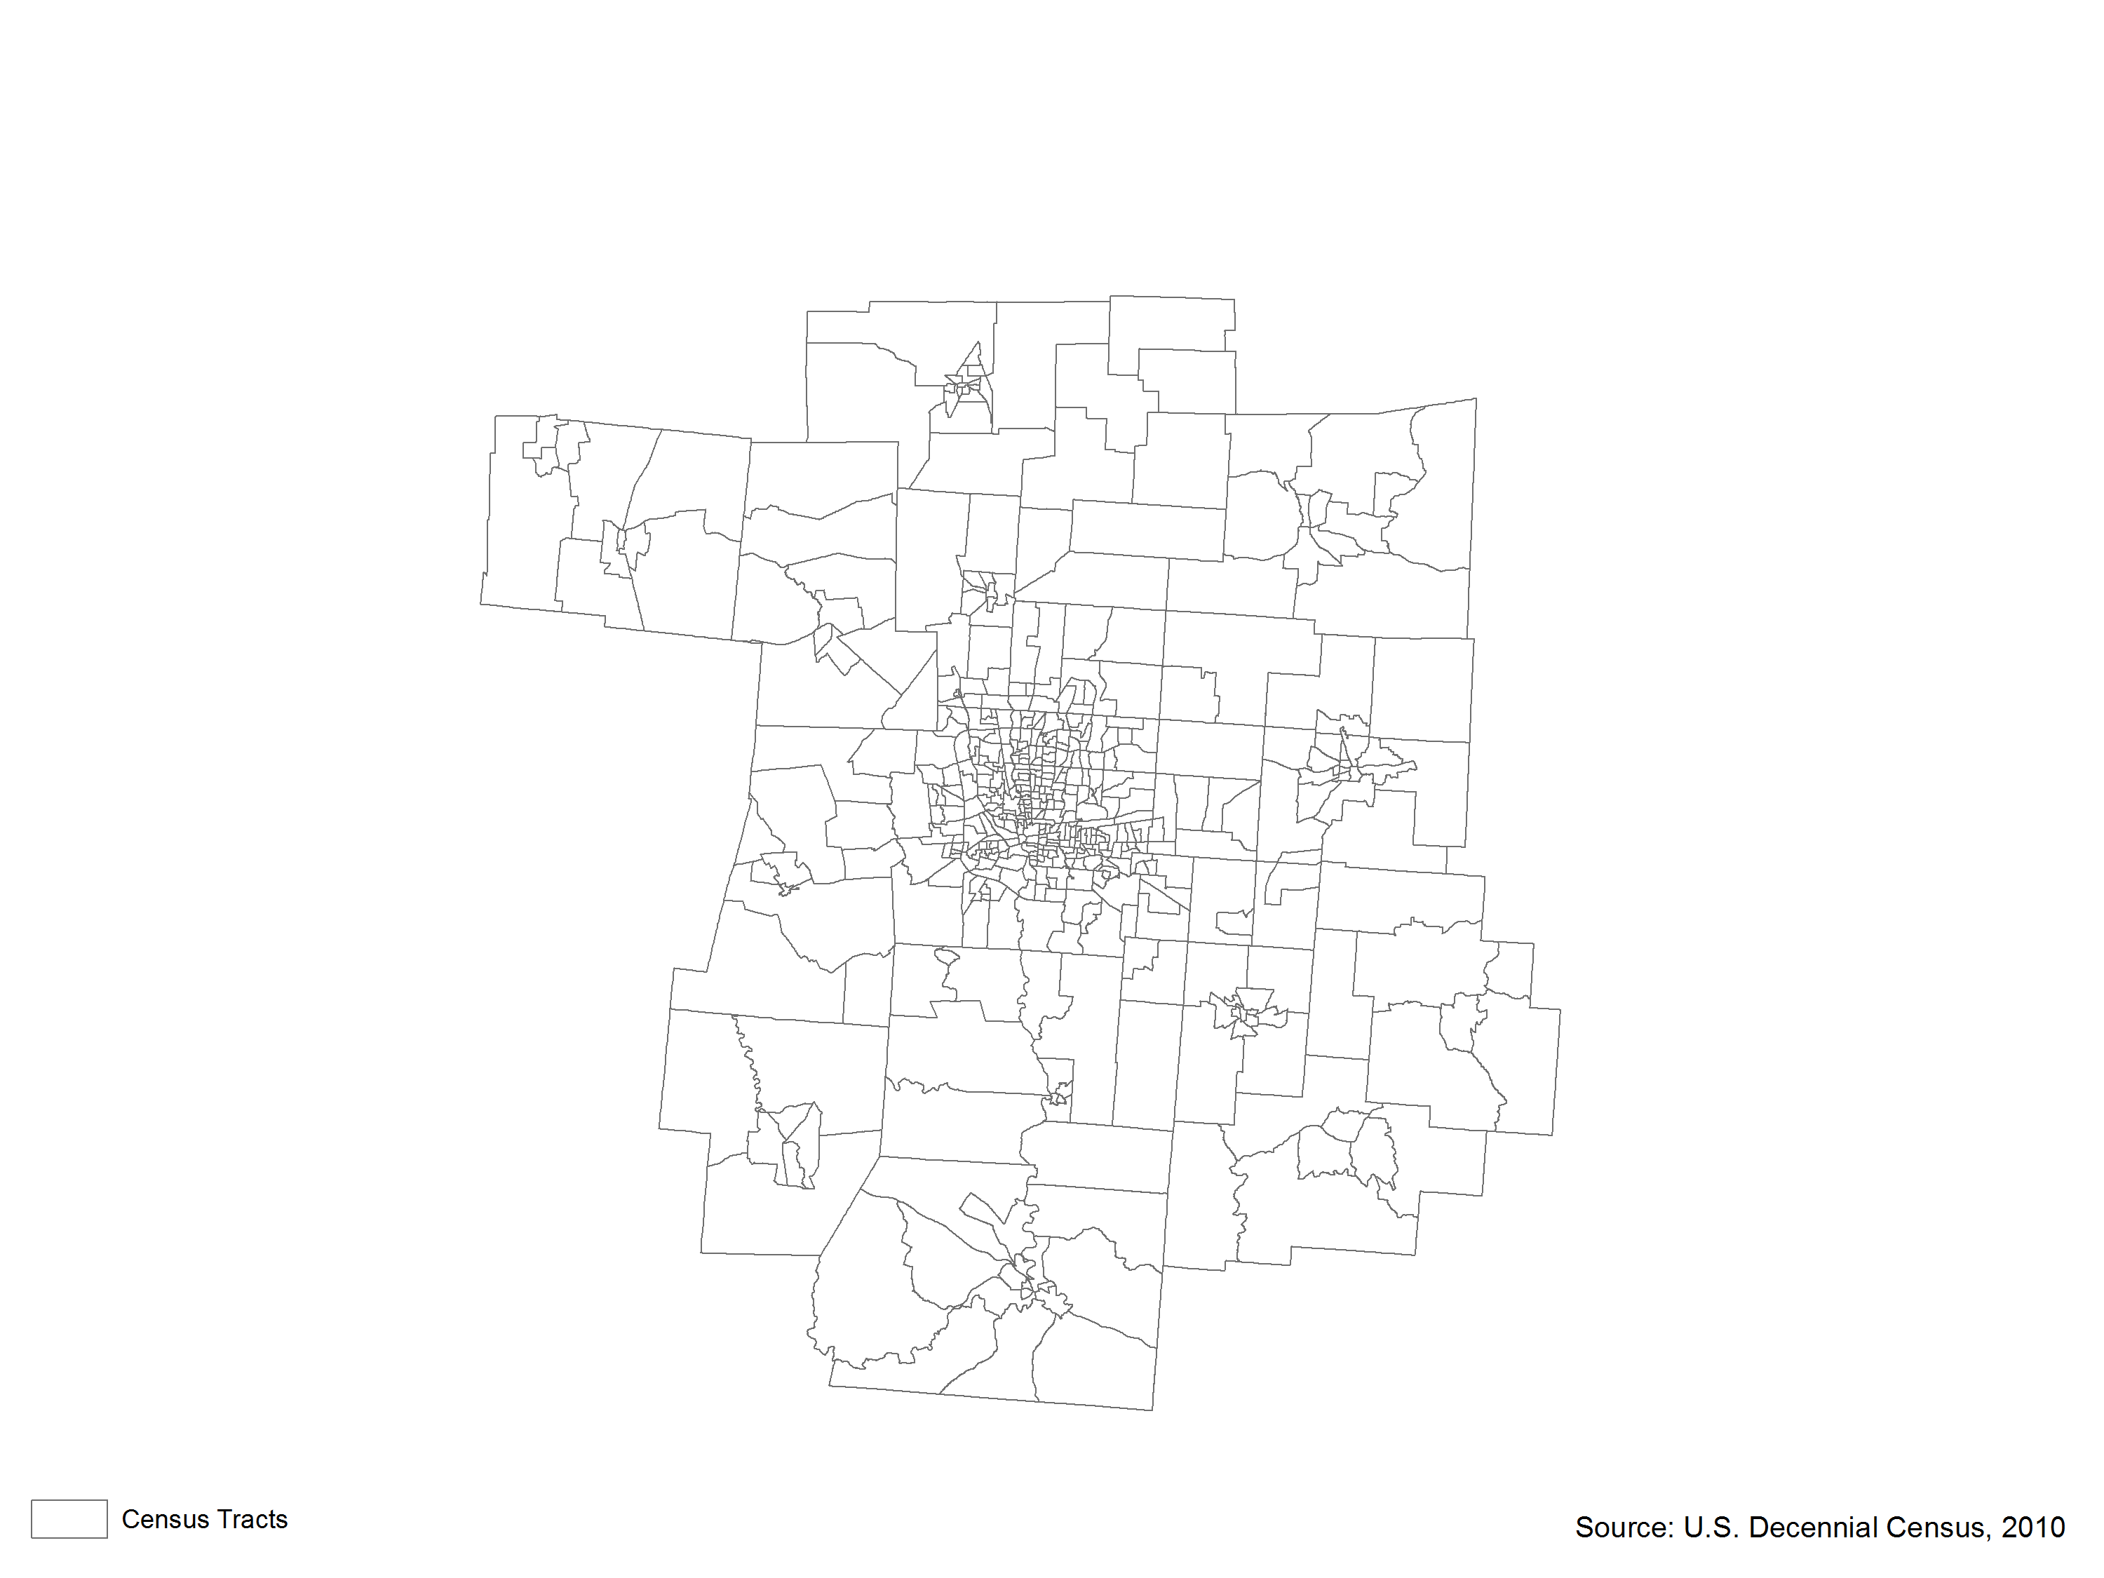
The Central Ohio Region Segregation by Census Tract

Slide 60
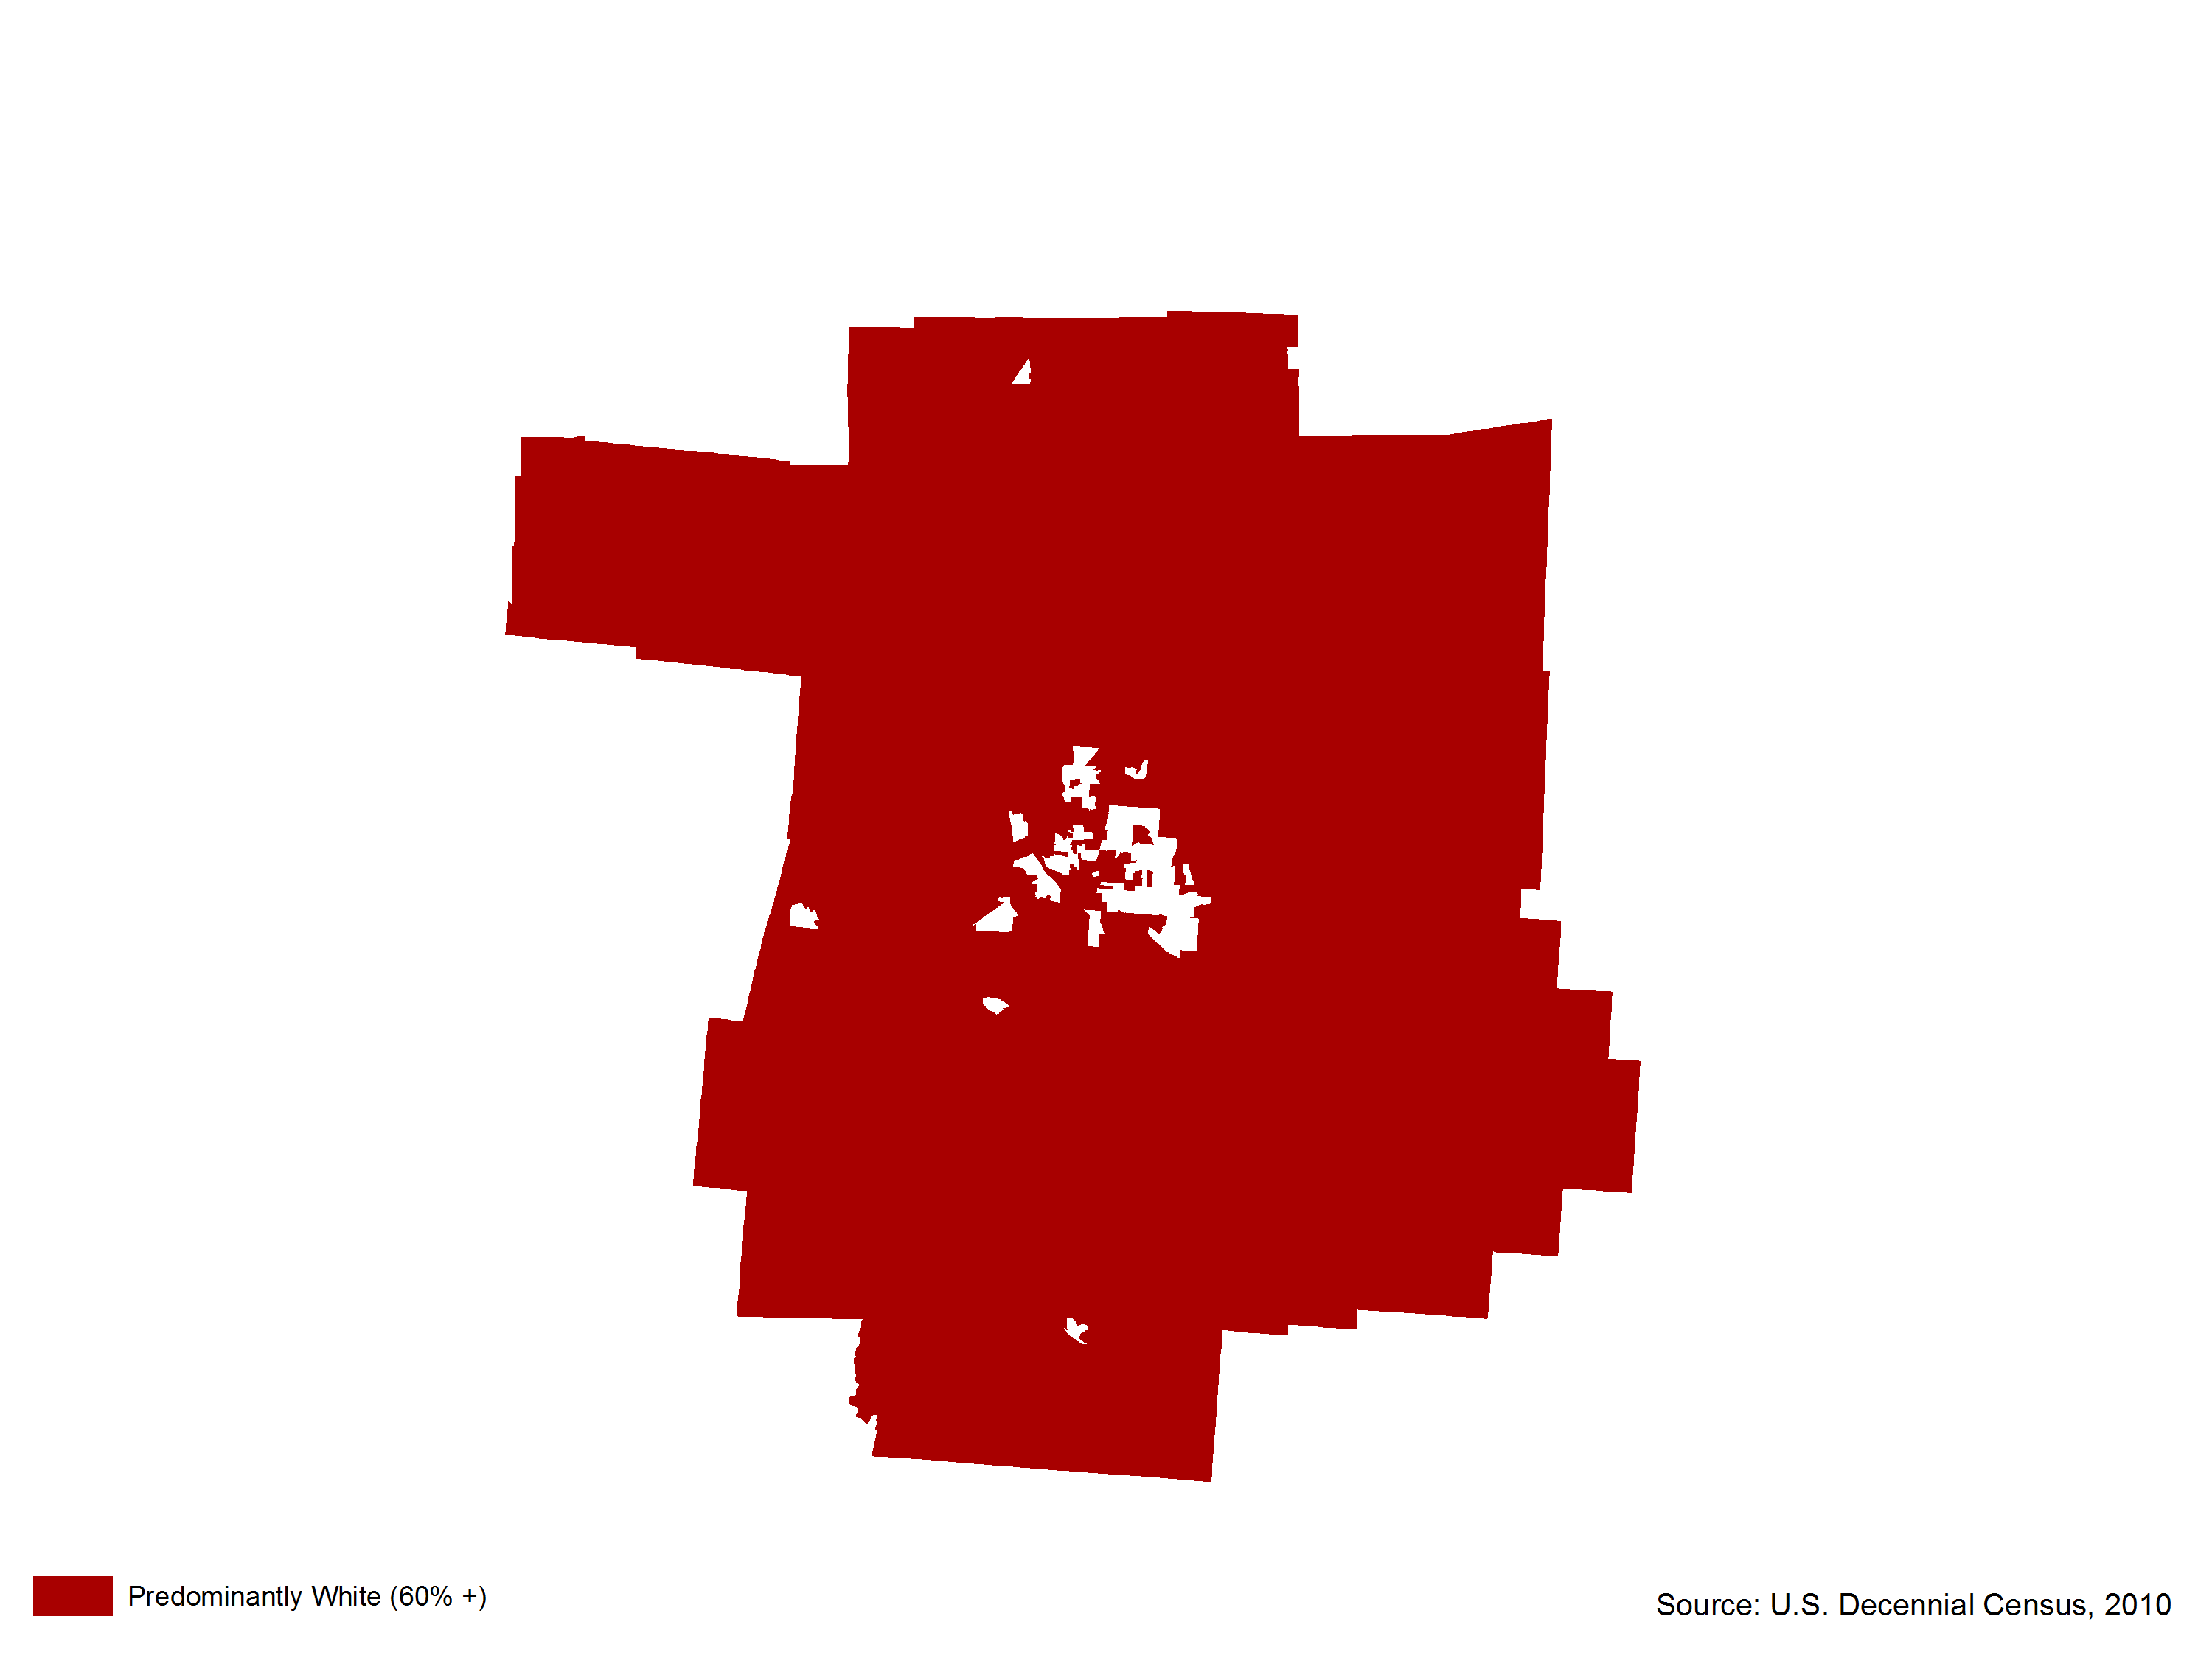
The Central Ohio Region Segregation by Census Tract

Slide 61
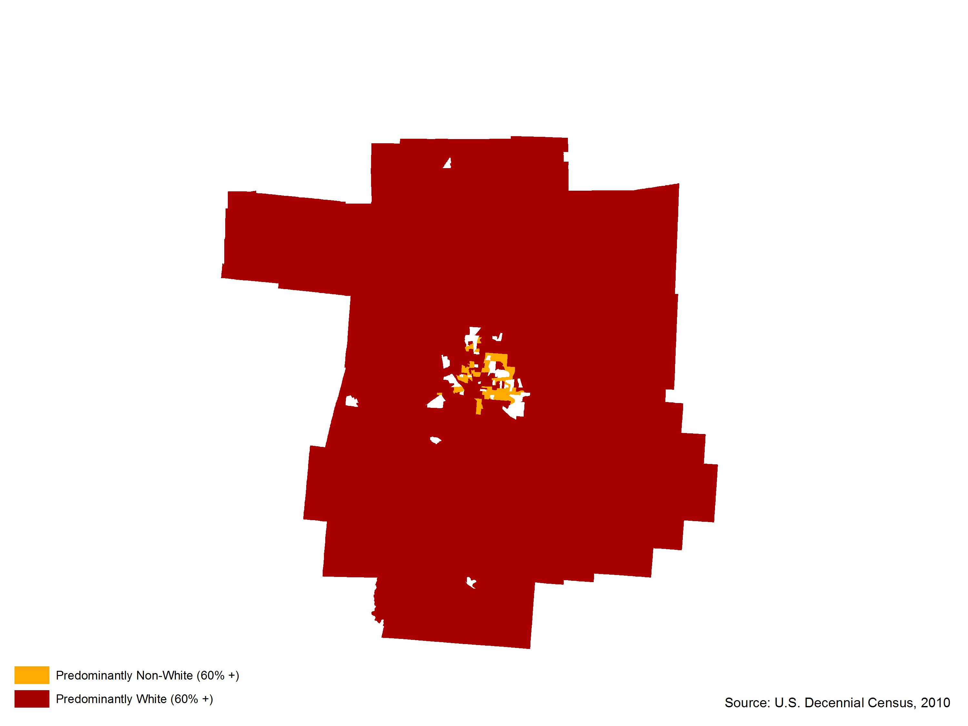
The Central Ohio Region Segregation by Census Tract

Slide 62

The Central Ohio Region Segregation by Census Tract

Slide 63
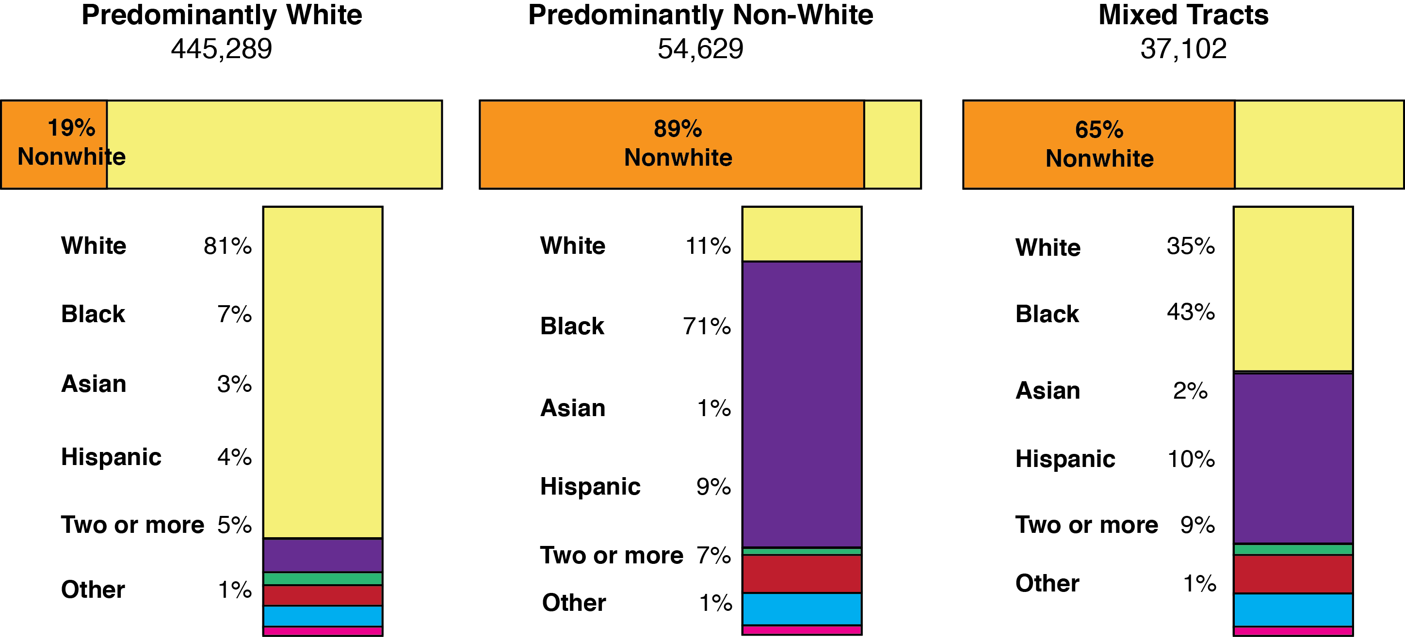
Distribution of School Age Population by
Race and Level of Neighborhood Segregation

Slide 64
The Central Ohio Region Poverty by Census Tract

Slide 65
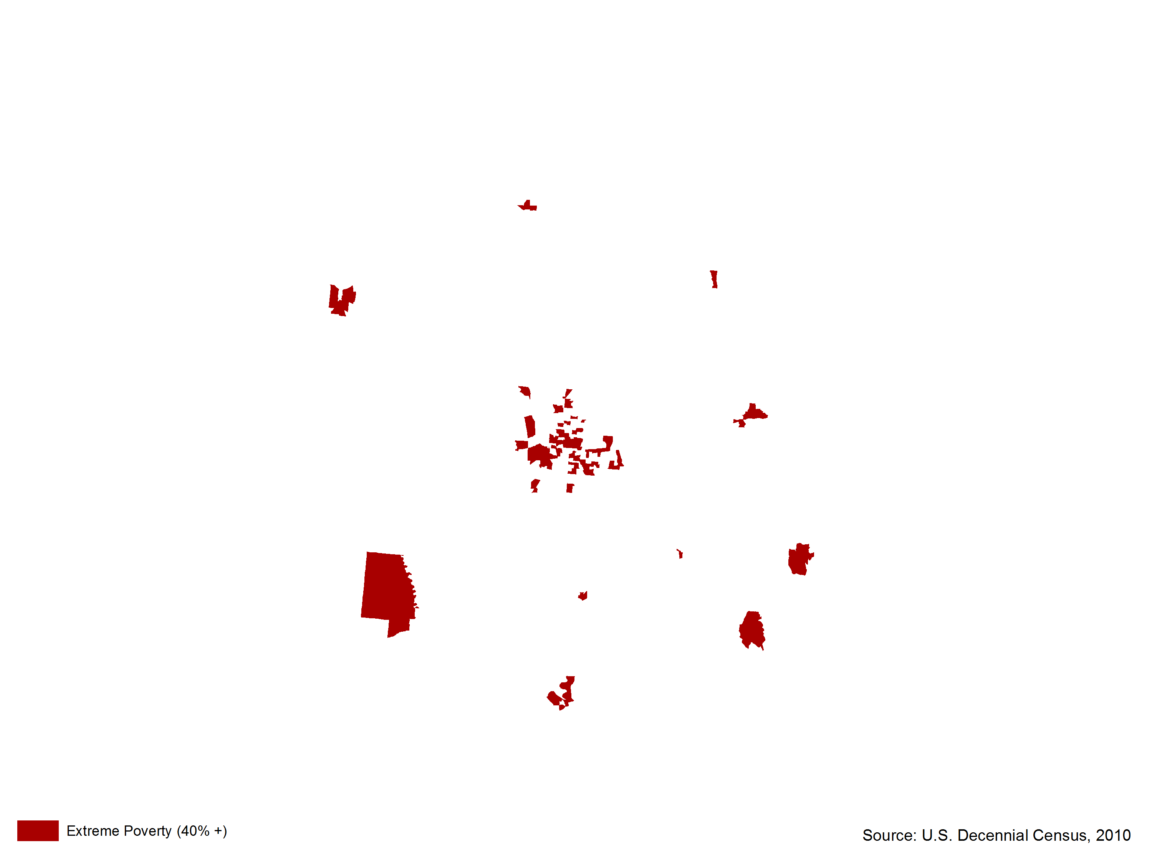
The Central Ohio Region Poverty by Census Tract

Slide 66
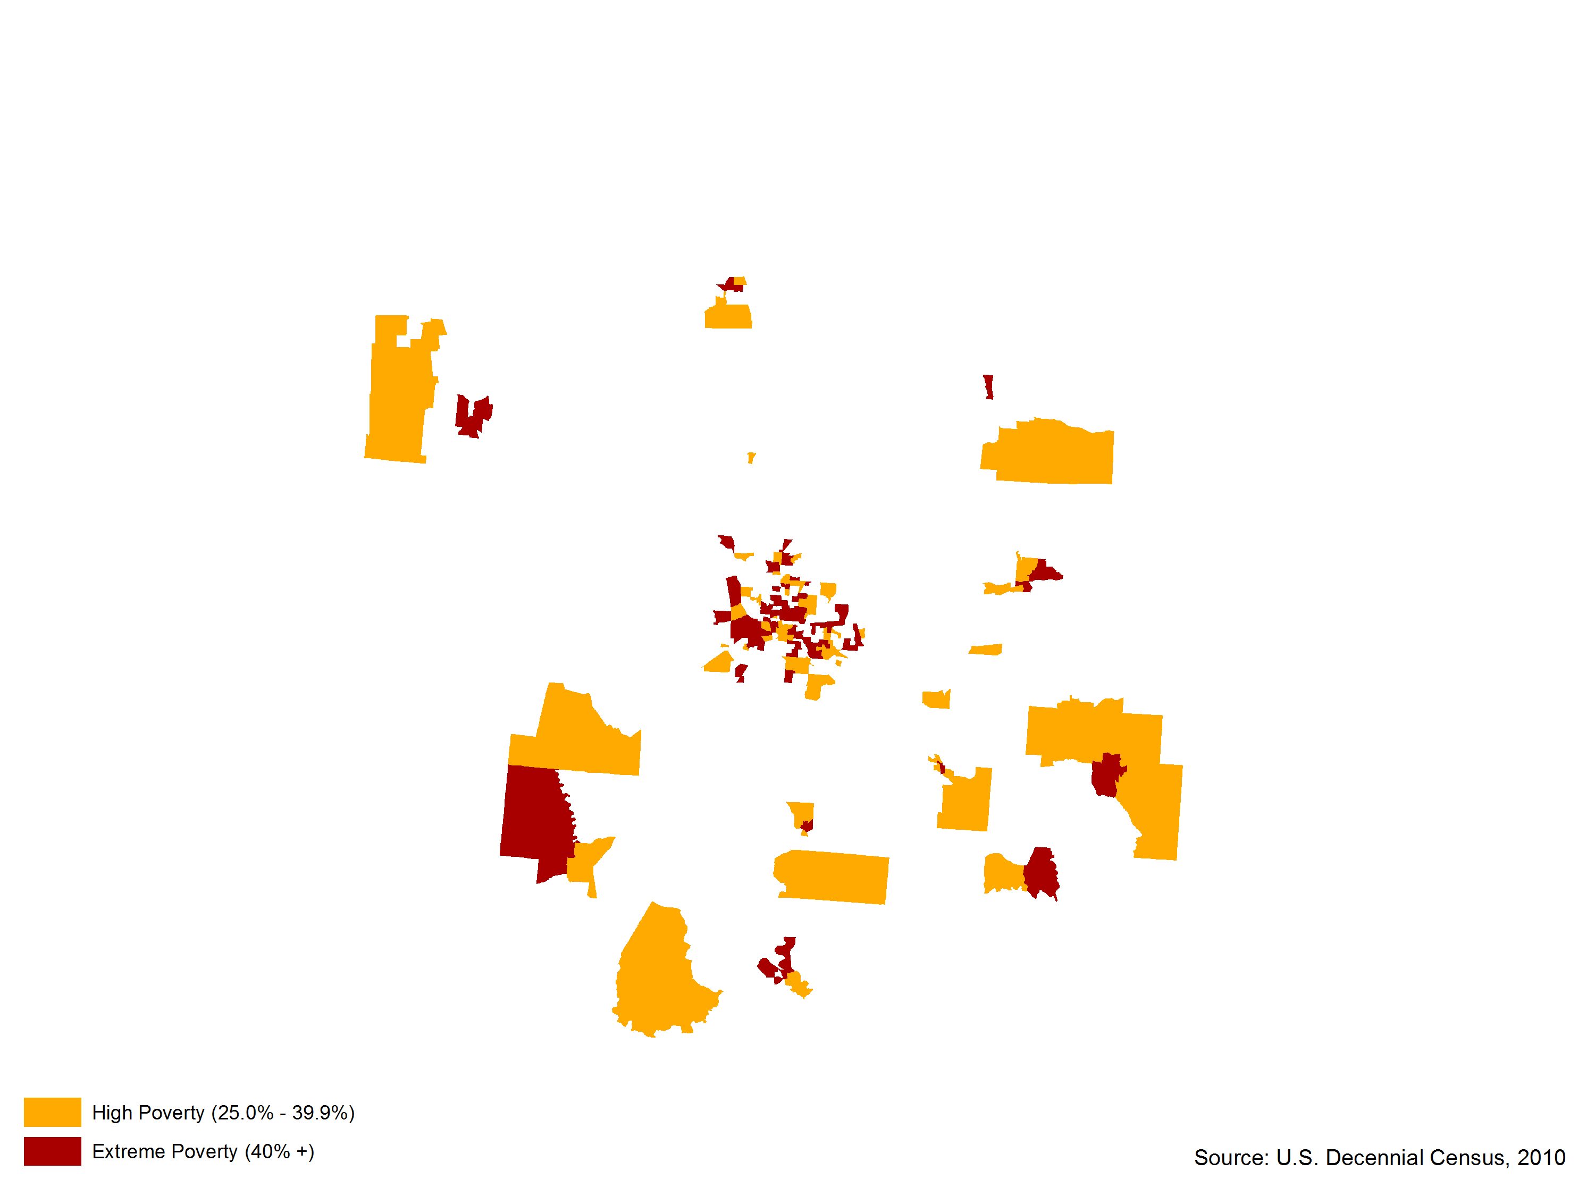
The Central Ohio Region Poverty by Census Tract

Slide 67
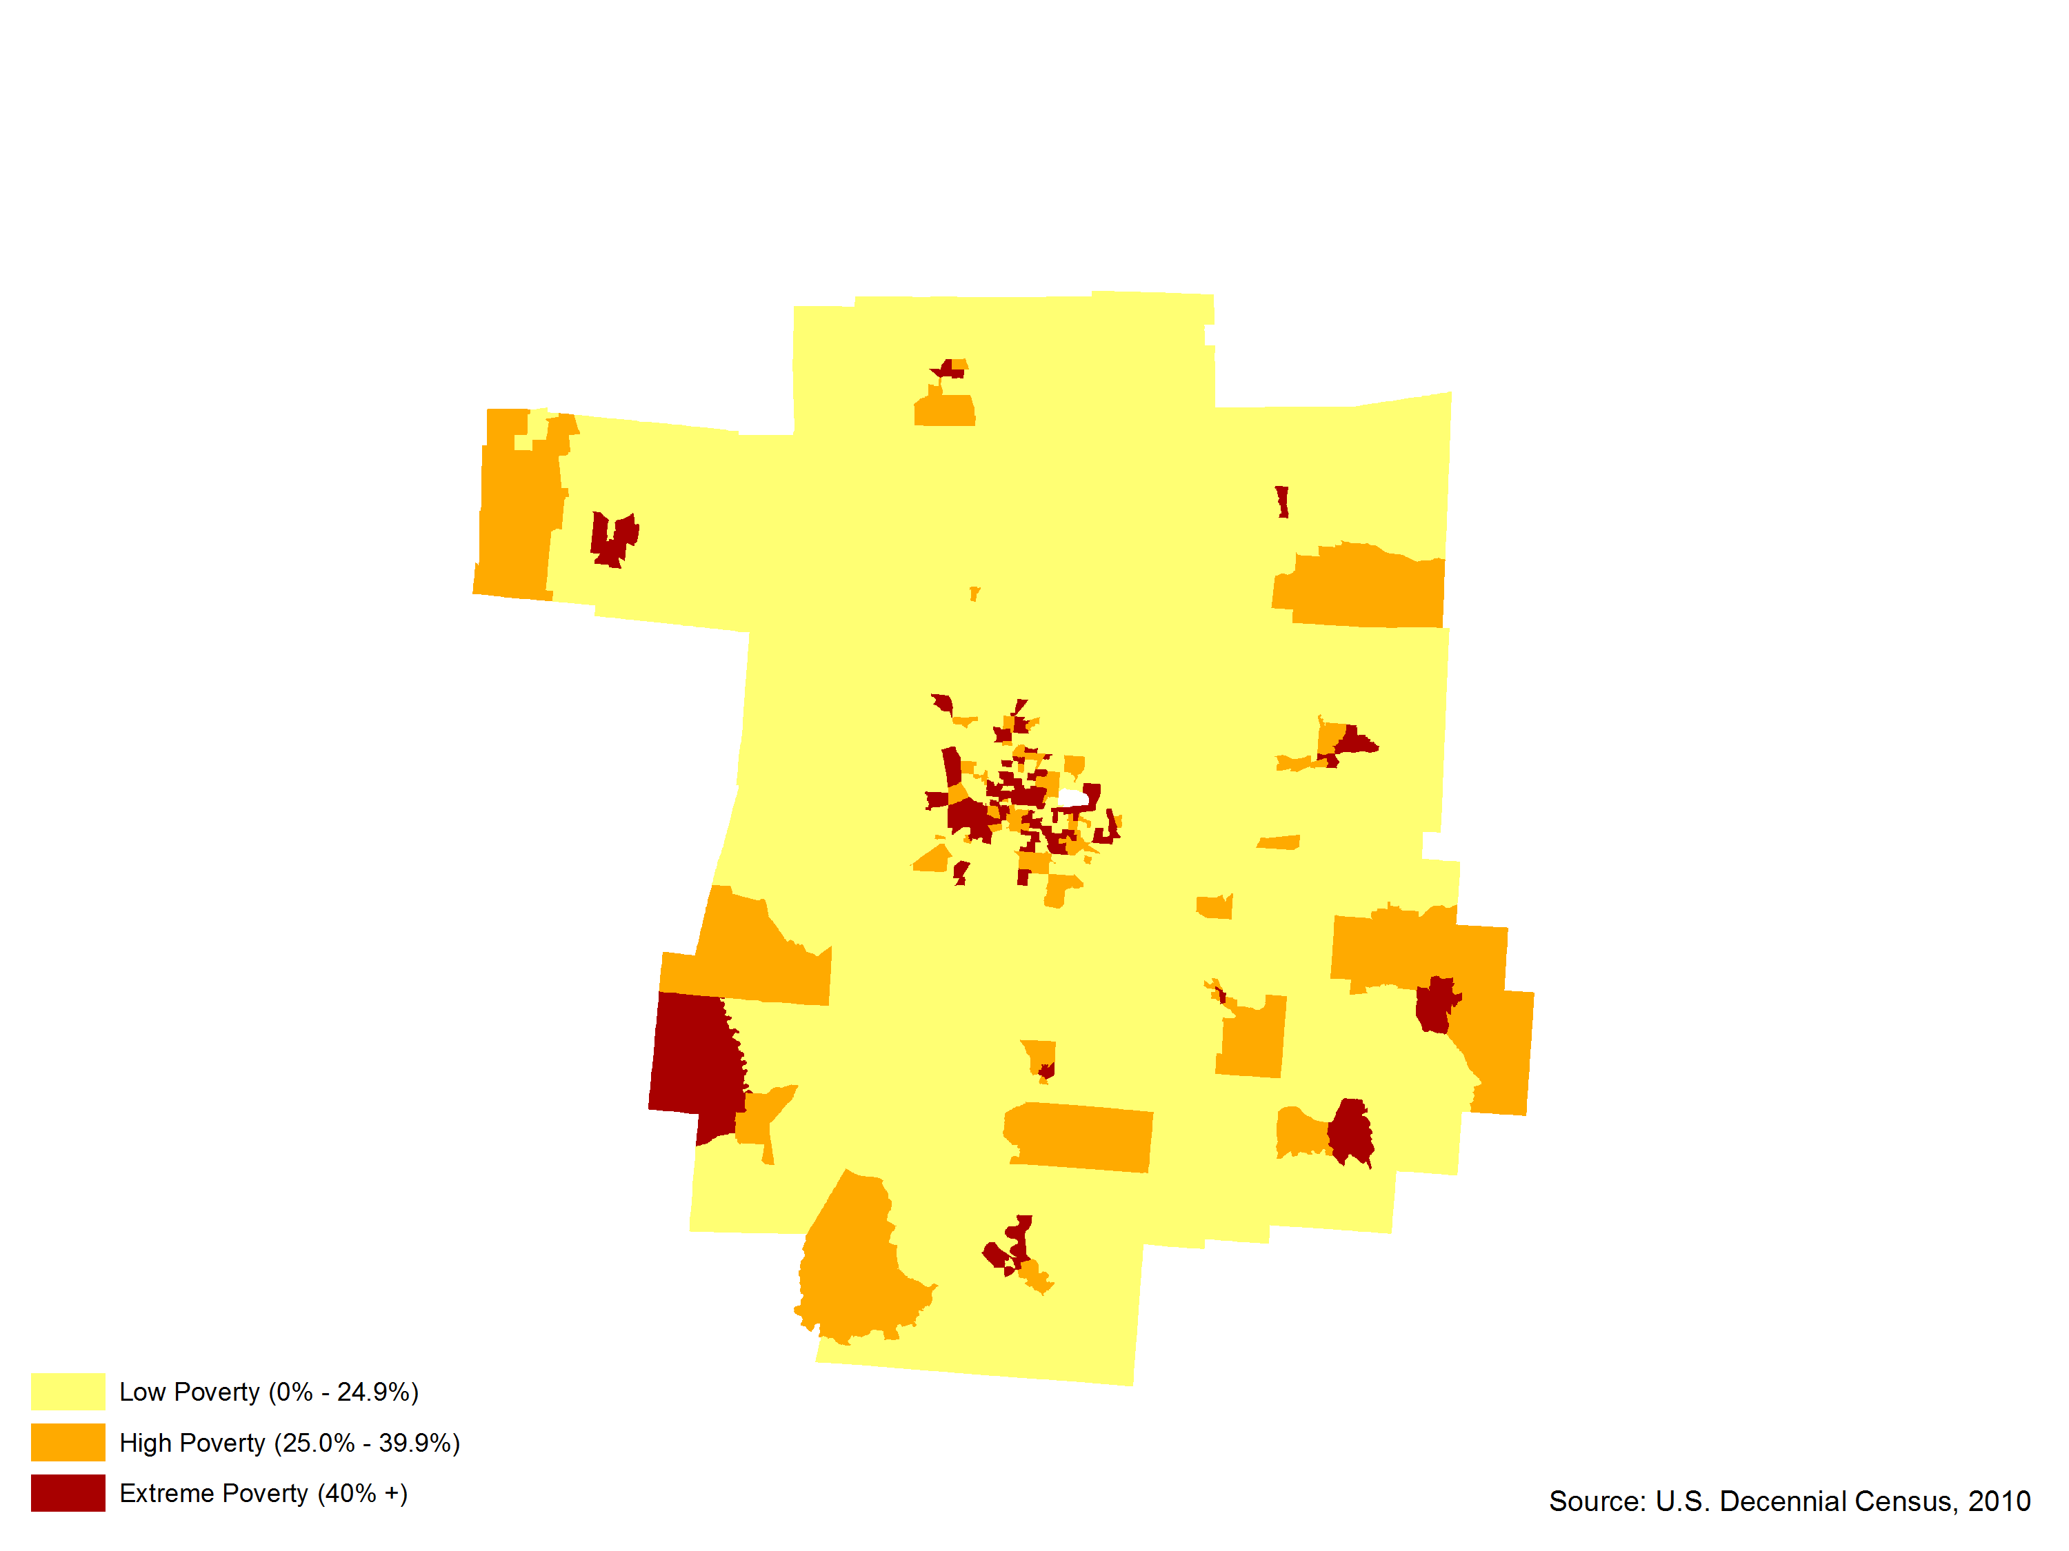
The Central Ohio Region Poverty by Census Tract

Slide 68
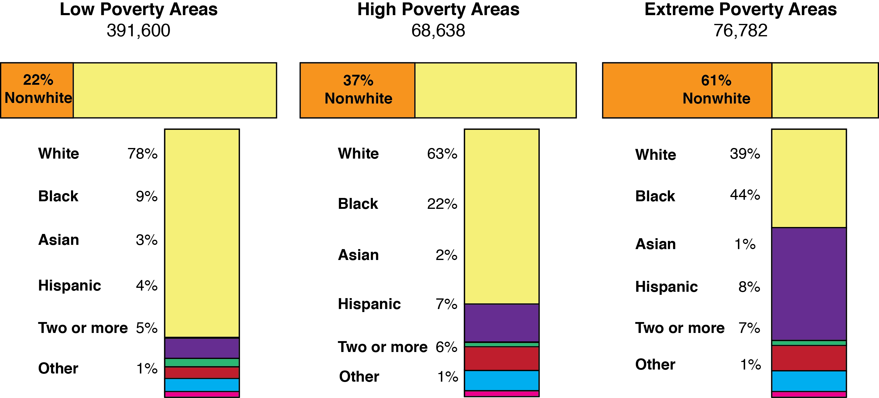
Distribution of School Age Population by
Race and Level of Neighborhood Poverty

Slide 69
The Triple Whammy of Geographic Disadvantage
Central Ohio Region

Slide 70
Golden Opportunities

Slide 71
The Aging Boomer Market
A $17 Trillion Prize Globally
Bloomberg BusinessWeek

Slide 72
Boomers will redefine what it means to be old

Slide 73
Remember
“The majority of Baby Boomers work and play little different from those in their 40s. They’re not obsessing over arthritis, incontinence, and dementia.”

Slide 74
The Aging Consumer Paradox
Seniors don’t like to be singled out and reminded that they are old.
The company that does a great job of making products for seniors takes great pains not to make products for seniors.

Slide 75
Encore Entrepreneurship

Slide 76
Fifty is the New 20
One quarter of 44-70+ population interested in becoming entrepreneurs.
Americans 55-64 start new business ventures at a higher rate than any other group, including 20 somethings.
23% of new entrepreneurs were age 55-64 in 2010, up from 14% in 1996.

Slide 77
Fifty is the New 20 Cont’d
50% of businesses started by 50+ entrepreneurs still operating 5 years later.
Encore Entrepreneurs alleged to have:
Double E-SP: Experience, Expertise, Seasoned Judgement & Proven Performance.

Slide 78
Promote Successful Aging
How do we help seniors age gracefully in their homes and their communities?
That is, how to help them age in place and keep them out of hospital emergency rooms, expensive nursing homes, and long term care facilities?
What role can digital technologies play in healthy aging?

Slide 79
Age-Related Challenges
Mobility Limitations
Hearing Loss
Vision Impairments
Mental Disorders
Substance Abuse Issues
Chronic Disabilities
Economic Constraints

Slide 80
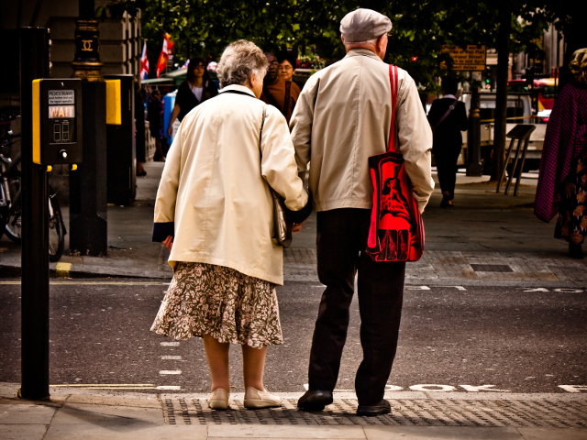
Think about Urban Design for Our Aging Population

Slide 81
Urban Design Principles
Visitability of institutional settings
Senior playgrounds & fitness parks
Universally accessible transport systems
Complete street ordinances
Extended walk times at pedestrian cross-walks
Senior friendly street signage

Slide 82
Implications for Central Ohio Region
Manage the transition from the “graying” to the “browning” of the region.
Embrace immigrants.
Devise strategies to address the region’s “triple whammy” problem.
Invest in business development & job creation potential of the elder care economy and diverse ethnic markets.
Pursue age-friendly community economic development.

Slide 83
THE END

