Slide 1
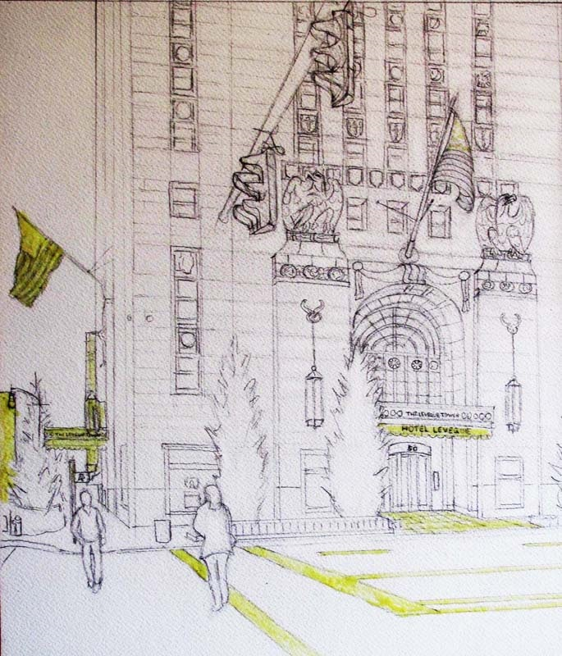
LeVeque Tower History

Slide 2
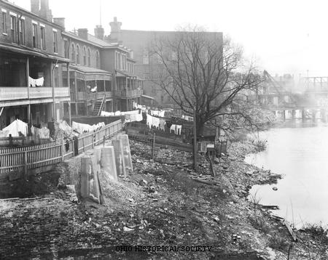
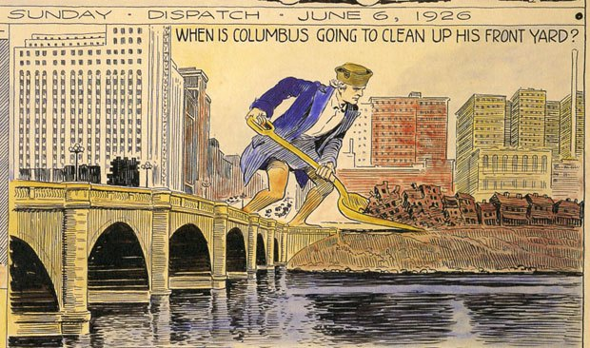
Columbus in the 1920s
Population grew from 125,000 in 1900 to over 237,000 in 1920
Fire at City Hall (where the Ohio Theatre stands) shifted focus to Riverfront
Columbus Civic Center taking shape along the Riverfront
By mid-1920s Central High School was built in Franklinton and City Hall was under construction
Historic view of the Scioto Riverfront in downtown Columbus in the early 1900s.

Slide 3
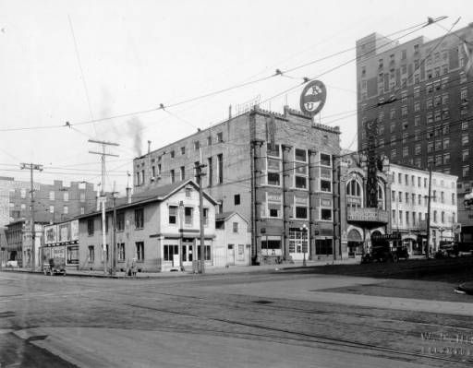
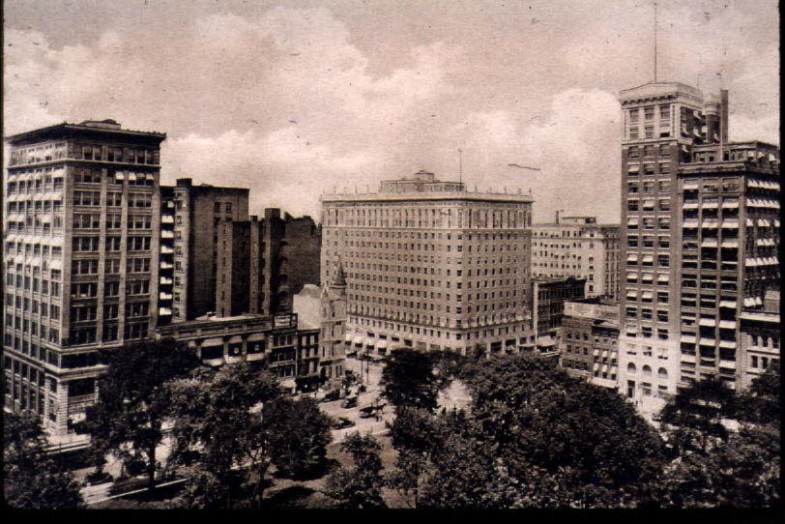
Downtown Columbus views before LeVeque (AIU Citadel) Construction
Site of the LeVeque Tower
View of Deshler-Wallick Hotel at Broad and High

Slide 4
American Insurance Union
John J. Lentz was the founder of the American Insurance Union
He envisioned a great structure that would replace the four-story building AIU occupied at the time
The building program called for “A building of outstanding beauty of line and design, ample room for expansion, and complete equipment for the needs of the American Insurance Union.”

Slide 5
Construction of AIU Citadel (American Insurance Union)
Architects: C. Howard Crane, Detroit (designed many movie theaters); Thomas Lamb, designed the Keith-Albee Palace Theater
Dedication: September 21, 1927
Height: 555.5’ (six inches taller than the Washington Monument)
Construction: Foundations over 100’ deep to bedrock, steel frame with white oak bark terra cotta exterior, highly ornamented with sculpture
Multi-Use Building: Office Tower, Keith-Albee PalaceTheater, and 600 rooms of the Deshler-Wallick Hotel, making it a 1,000 room hotel

Slide 6
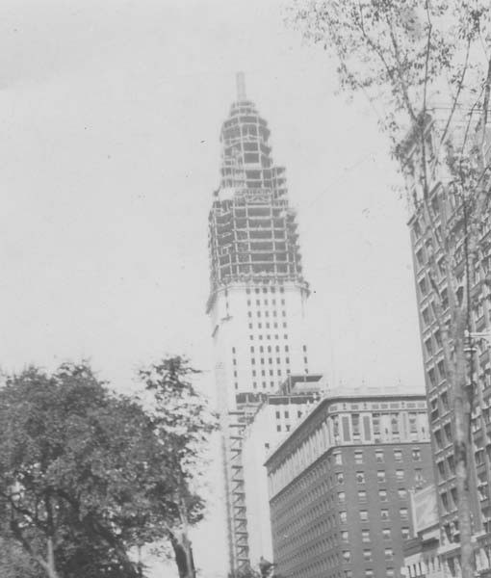
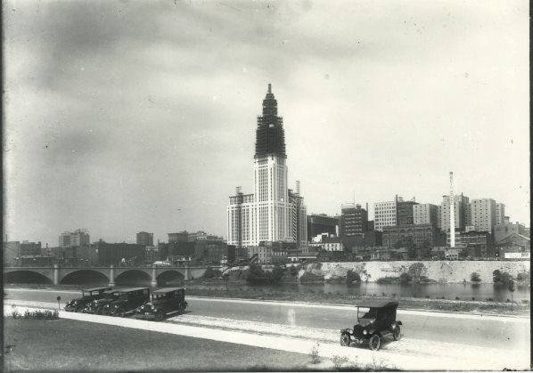
Construction of AIU Citadel (American Insurance Union)

Slide 7
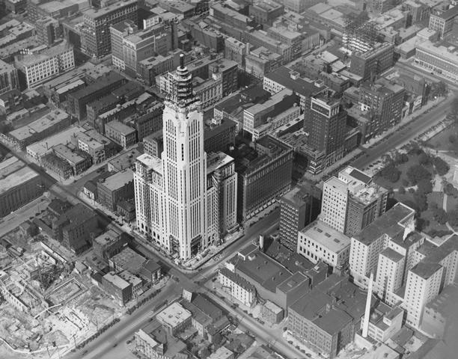
AIU Citadel under construction with City Hall under construction in the lower left corner of the photo.

Slide 8
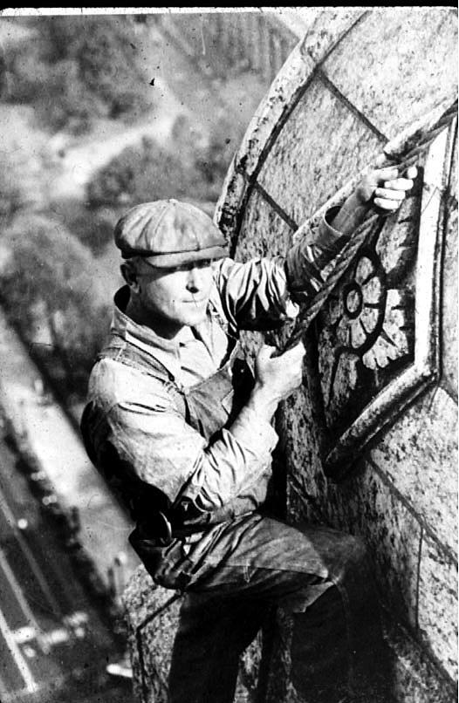
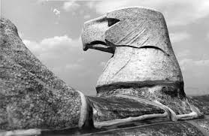
Sculpture at the top of the tower

Slide 9
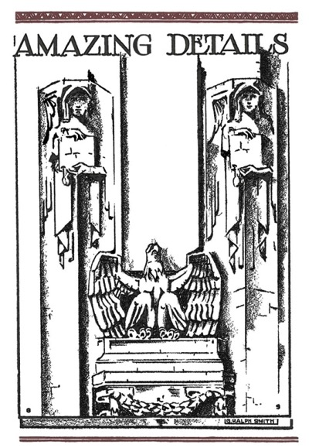
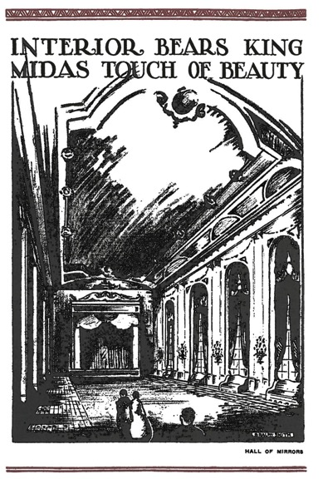
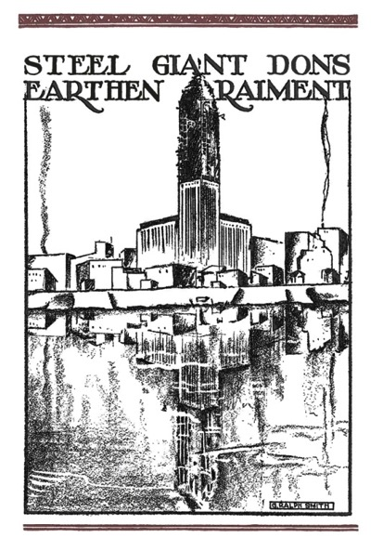
AIU Citadel Dedication Booklet September 21, 1927

Slide 10
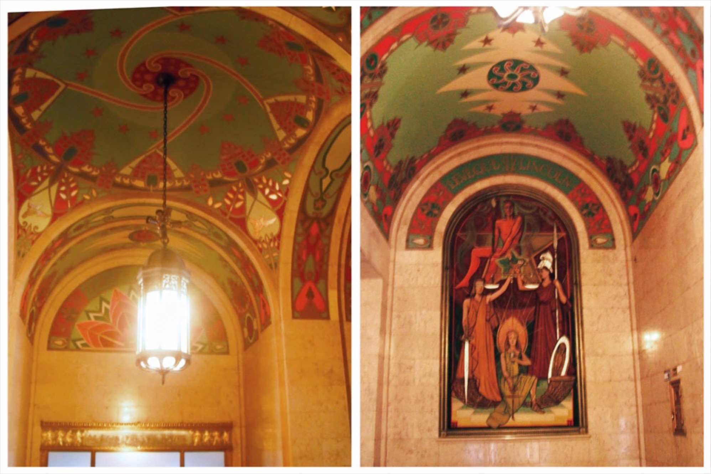
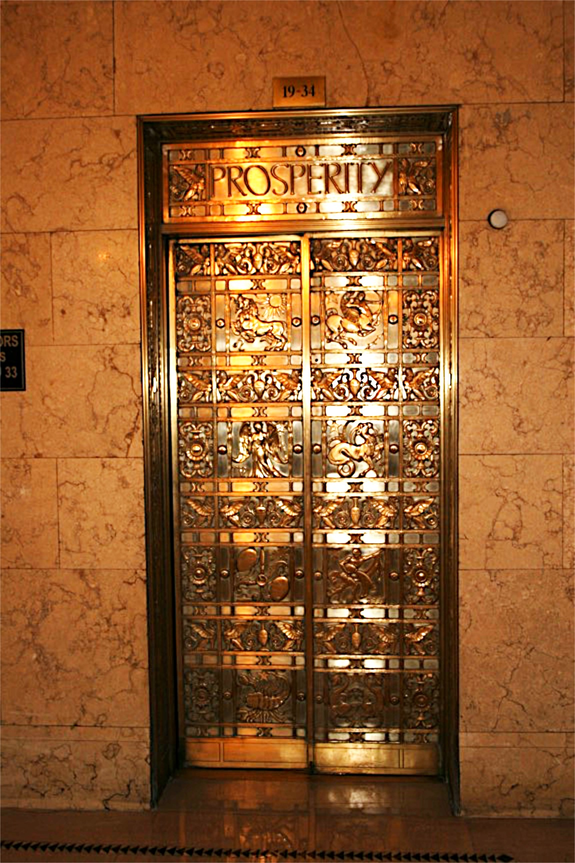

Slide 11
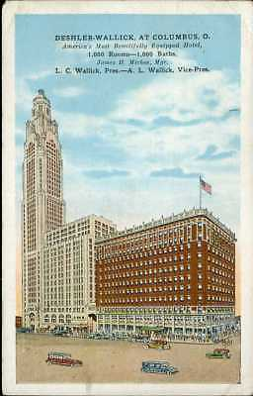
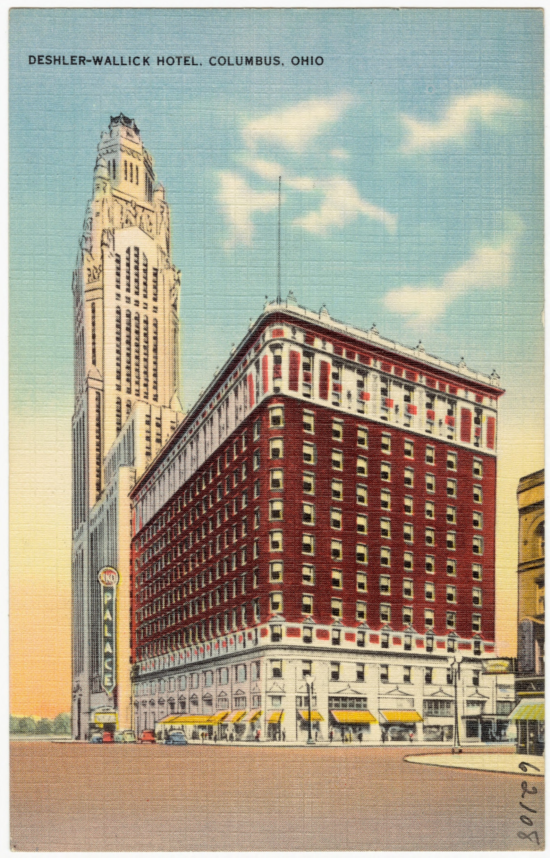

Slide 13
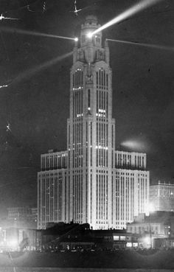
“The Citadel is America’s first aerial lighthouse and beacons serve a two-fold purpose. With a visibility of 80 or 90 miles from the sky, they are a guide for night-flying aviators, who may shape their courses accordingly. Also, they hold forth a warning to airmen passing over the city that a mighty tower of unusual height governs the skyline.”
AIU Citadel Dedication Booklet, September 21, 1927

Slide 14
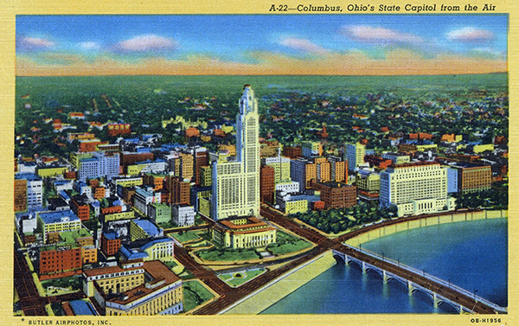
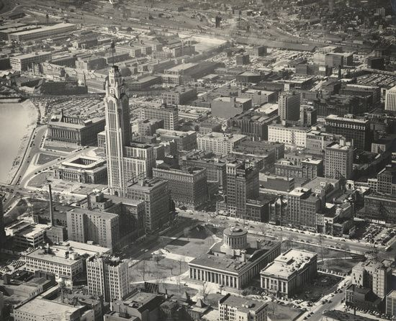
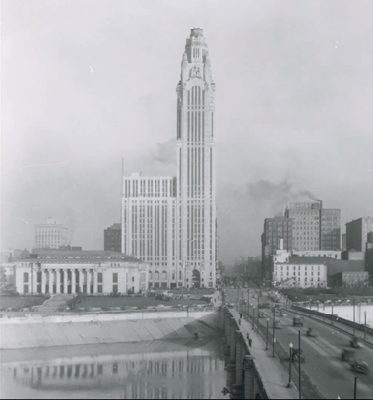
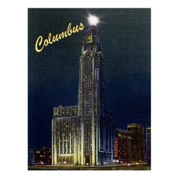

Slide 15
AIU Citadel to Lincoln-LeVeque
AIU went bankrupt
John Lincoln and Leslie LeVeque purchase the building in 1945
Deshler Hotel Annex (in LeVeque) closed in 1964; hotel demolished in 1967
Observation deck at the top of the building through the 1960s
Katherine LeVeque bought out the Lincoln family interests; renamed the building the LeVeque; renovated the Palace Theater and donated it to CAPA
Several changes of ownership in the early 2000, until new ownership in 2011

Slide 16
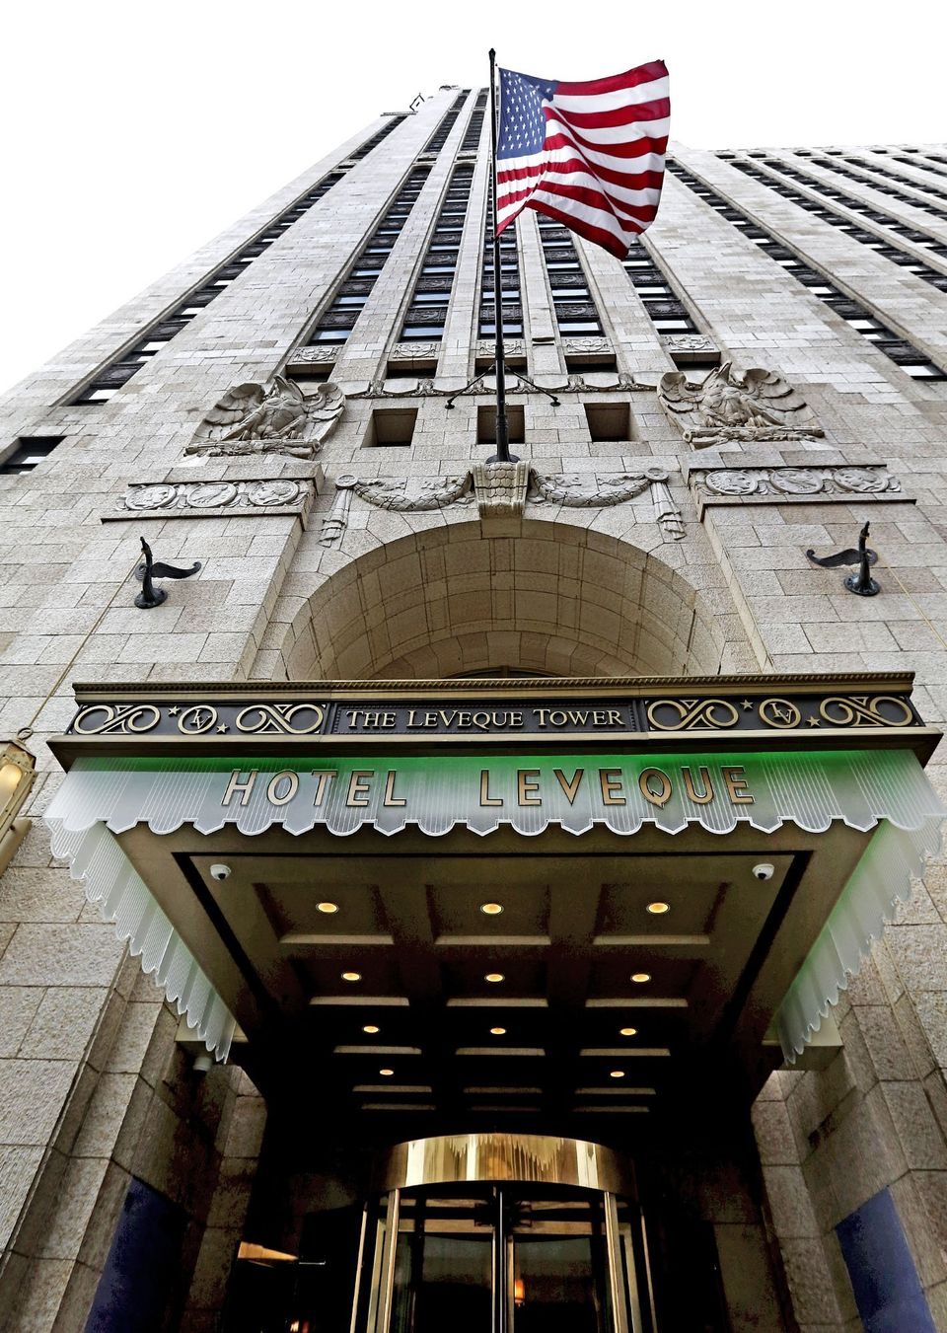
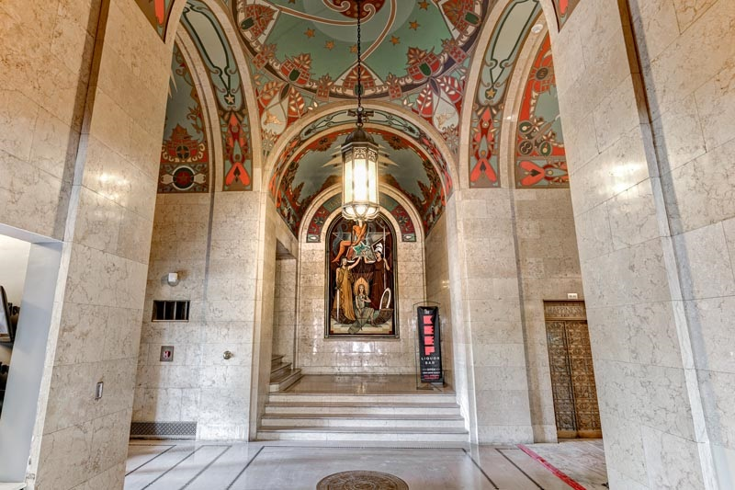
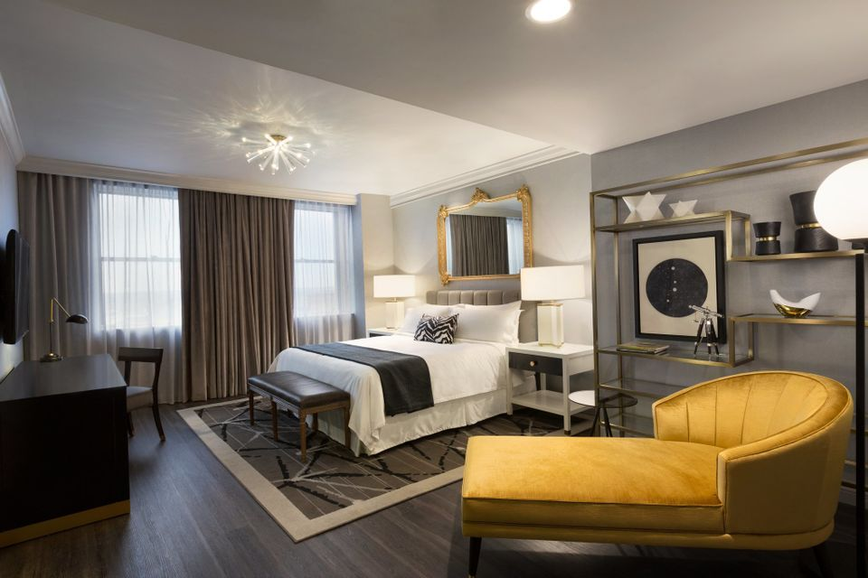
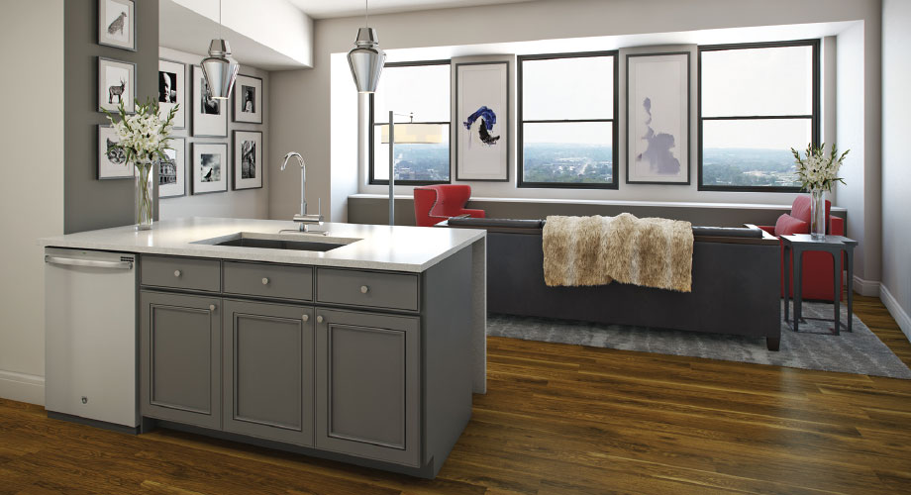

Slide 17
Photo Credits
Columbus Metropolitan Library Collection
Schooley Caldwell Architects
AIU Citadel Dedication Booklet
Wikipedia
Ohio History Center
Drawing by Jim Siemer
Editorial Cartoon from the Billy Ireland Cartoon Library, OSU

